Slide 1
Non-Negative Tensor Factorization with RESCAL
Denis Krompaß¹, Maximilian Nickel¹, Xueyan Jiang¹ and Volker Tresp^{1,2}
¹ Department of Computer Science. Ludwig Maximilian University, Oettingenstraße 67, 80538 Munich, Germany
² Corporate Technology, Siemens AG, Otto-Hahn-Ring 6, 81739 Munich, Germany

Slide 2
Overview
Non-Negative Matrix Factorization
Multiplicative Updates
RESCAL
Non-Negativity for RESCAL
Experiments
Benefits and Drawbacks

Slide 3
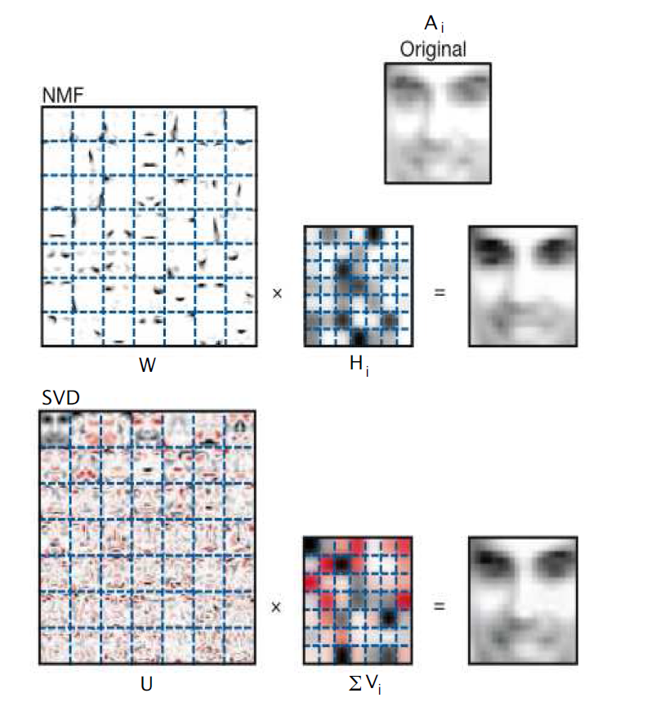
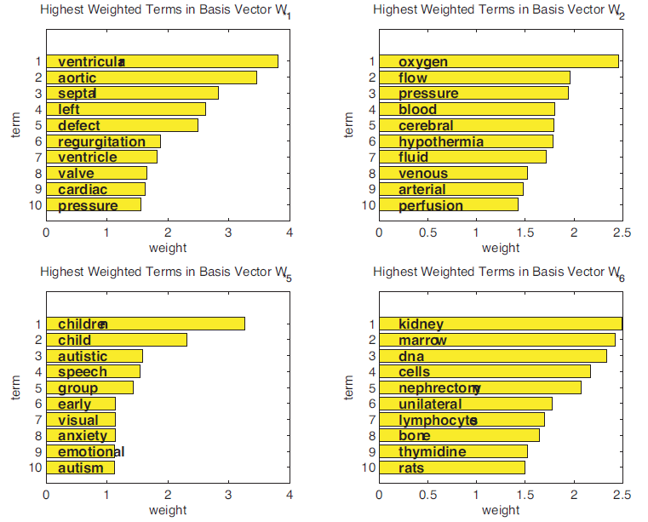
Non-Negative Matrix Factorization
Factorize a Matrix/Tensor into non-negative factors e.g. X = AV
Allows interpretation of latent factors
Can be directly used for clustering
Enforces sparse factors

Slide 4
Multiplicative Updates
Introduced by Lee & Seung in 2000
Used by Mørup and Hanson to infer NN Tucker decomposition
Define a cost-function C(θ)
Derive the partial derivative with respect to θ_{i}
Identify negative and positive part of the derivative and construct update function:
Negative part of the derivative
Positive part of the derivative

Slide 5
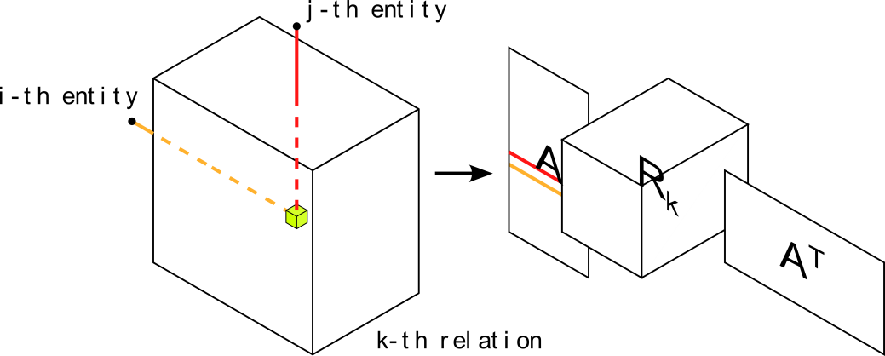
RESCAL Tensor Factorization for Relational Learning
Three-way-tensor factorization model
Showed very good results in various relational learning tasks [5,8]

Slide 6
Non-Negative Constraint for RESCAL
Regularized Least-Squares Cost Function
Regularized Kullback-Leibler-Divergence Cost Function

Slide 7
Normalization and Integrating Entity Attribute Information
Normalization of Factor Matrix A [13]
Add attribute information to the model [8]
Include
Also for KL-Divergence Cost-Function

Slide 8
Experiments
Nations 14 x 14 x 56 multi-relational data that consist of relations between nations (treaties, immigration, etc). Additionally the dataset contains attribute information for each entry.
Kinship 104 x 104 x 26 multi-relational data that consist of several kinship relations within the Alwayarra tribe.
UMLS 135 x 135 x 49 multi relational data that consist if biomedical relationships between categorized concepts of the Unified Medical Language System (UMLS).
10 x cross-validation
Initialized the non-negative factor matrices with Non-negative Double Singular Value Decomposition method (NNDSVD)[9]
Nonzero entries were defined as entries smaller than -1.0e-9 or greater than 1.0e-9.

Slide 9
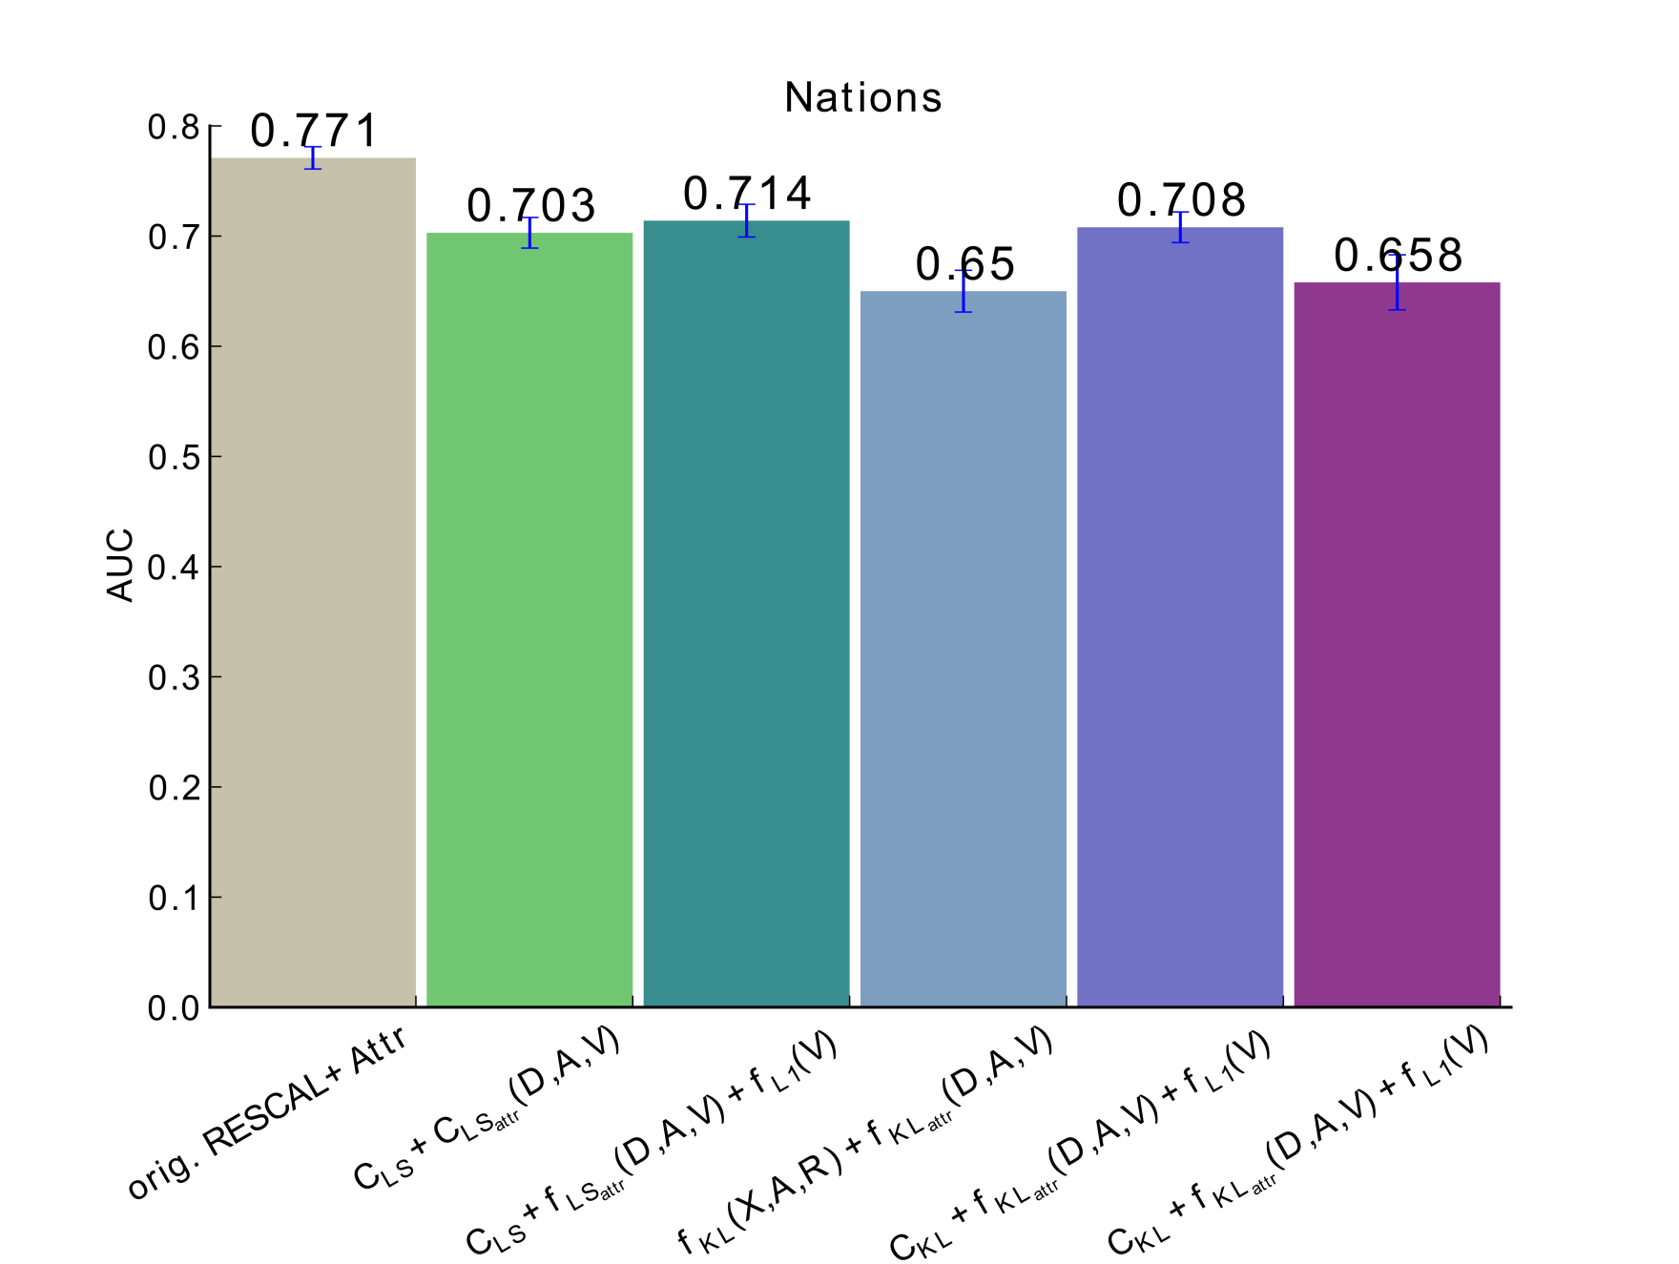
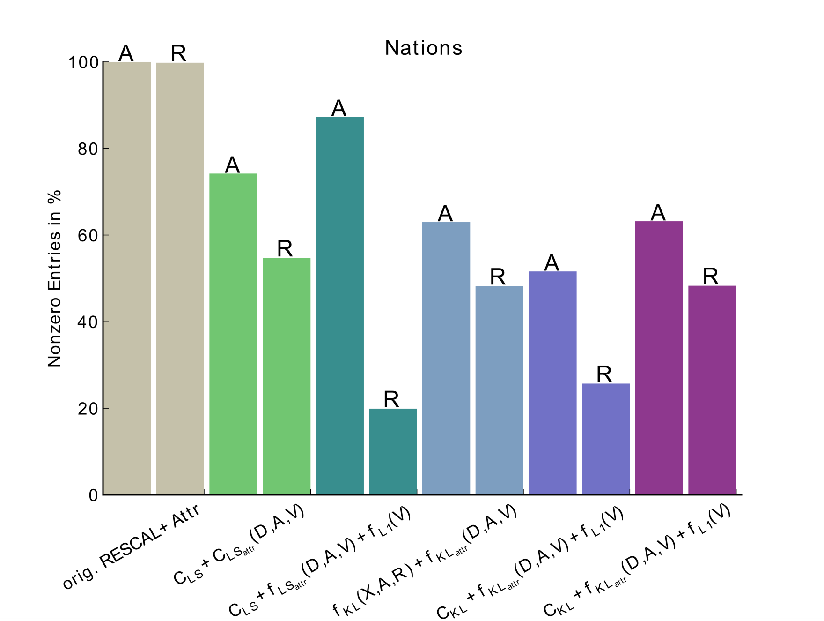
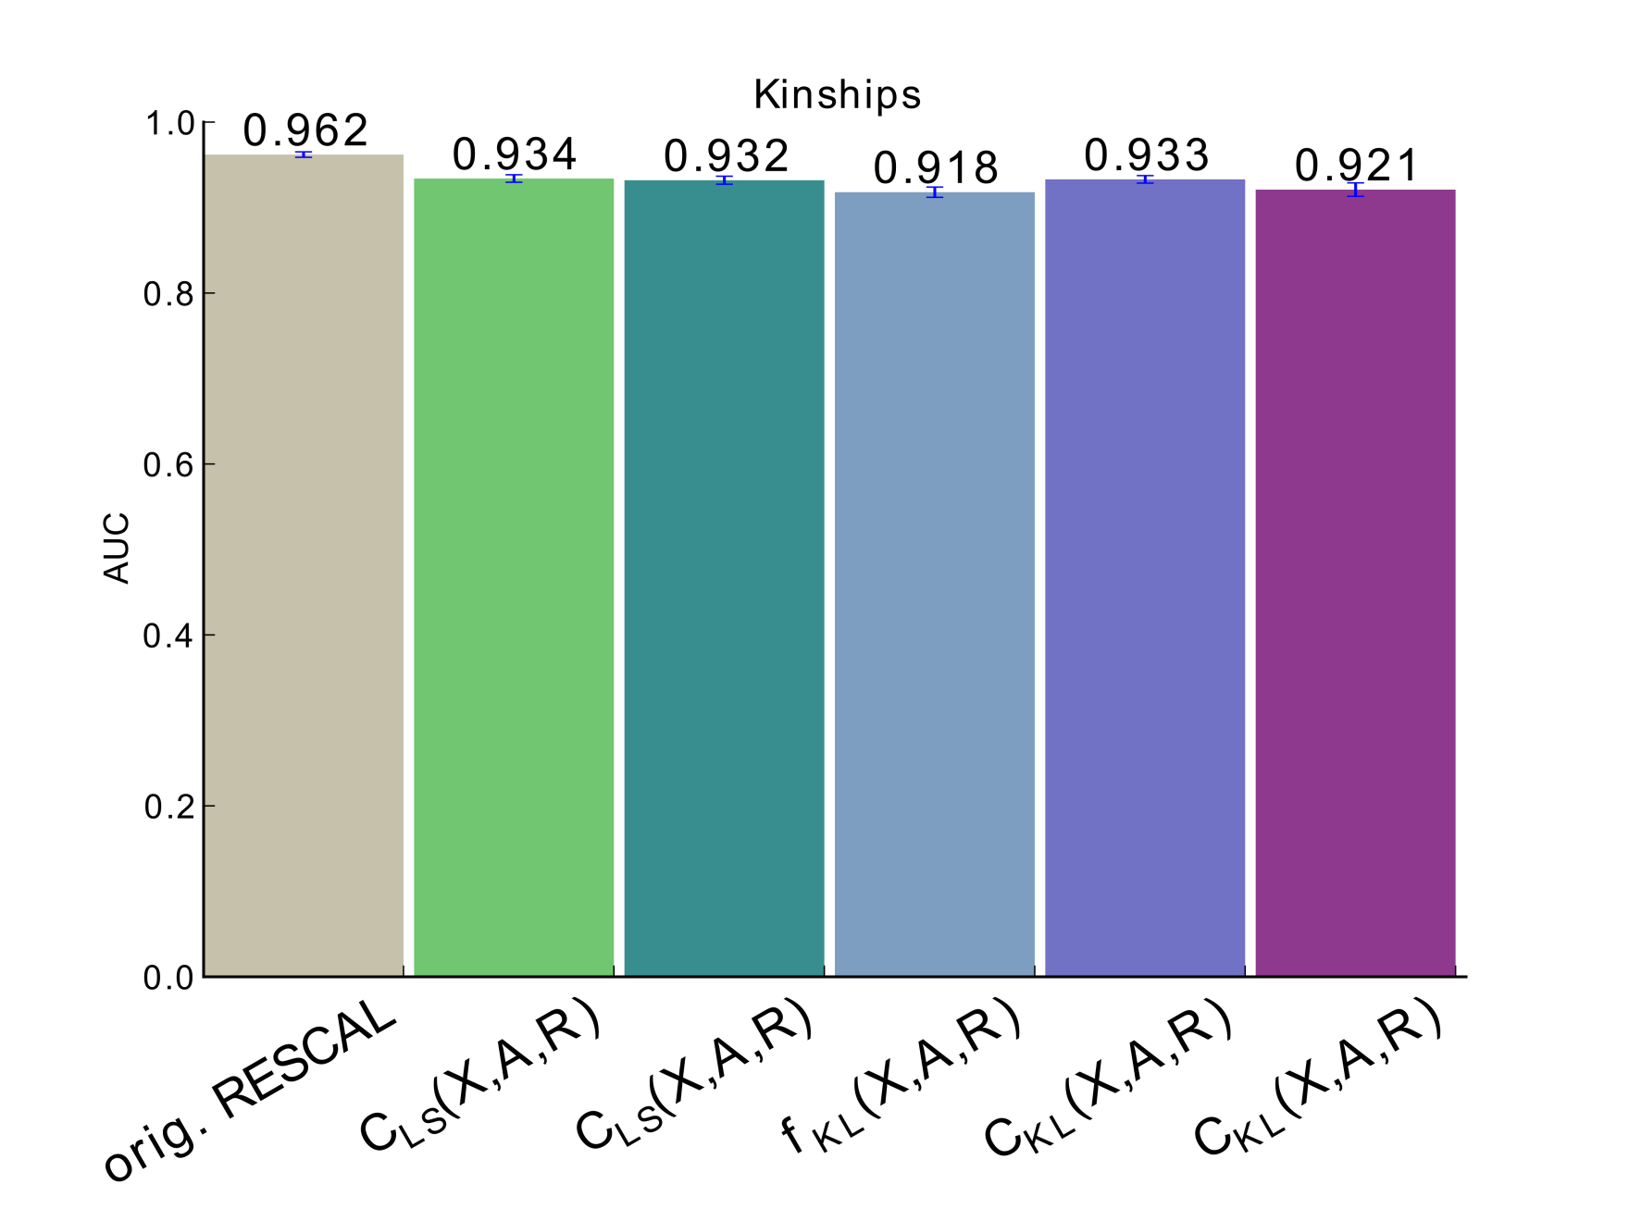
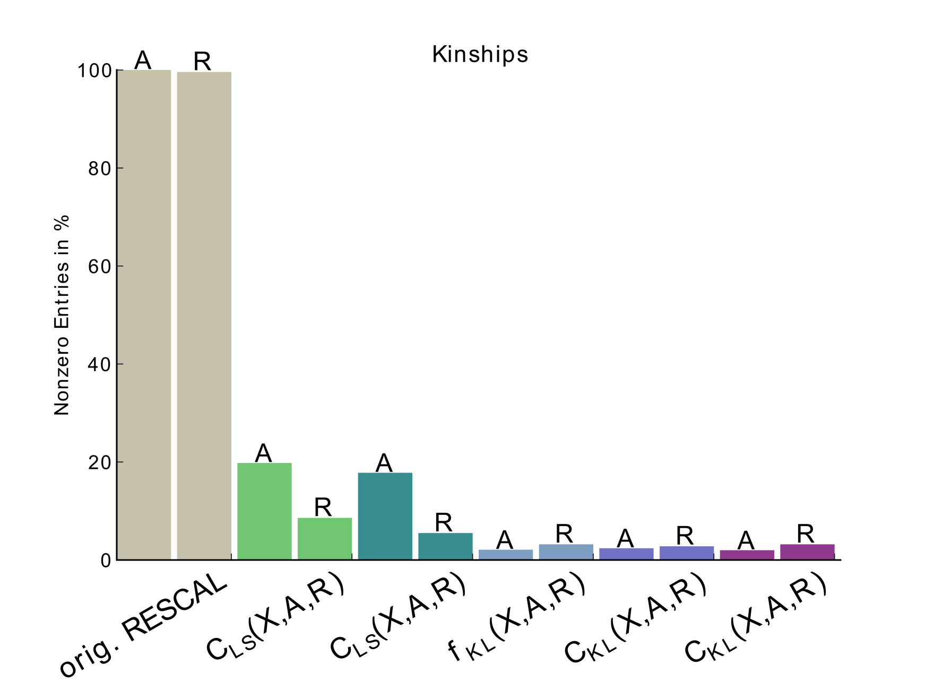
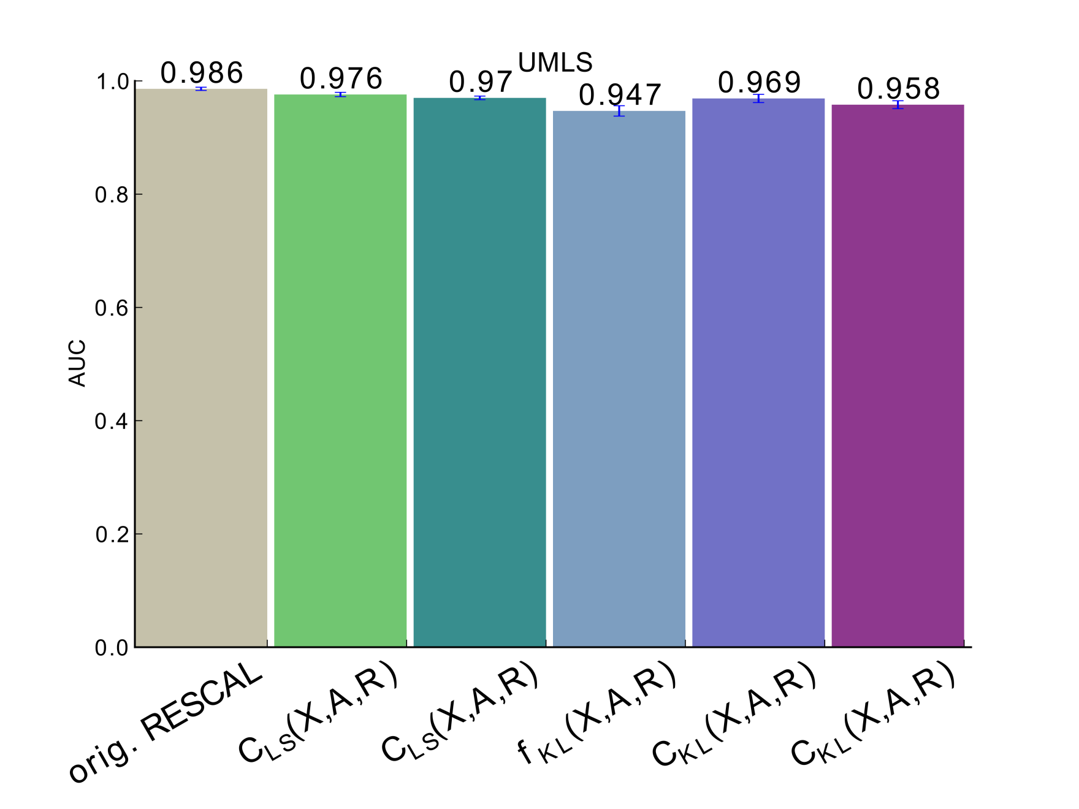
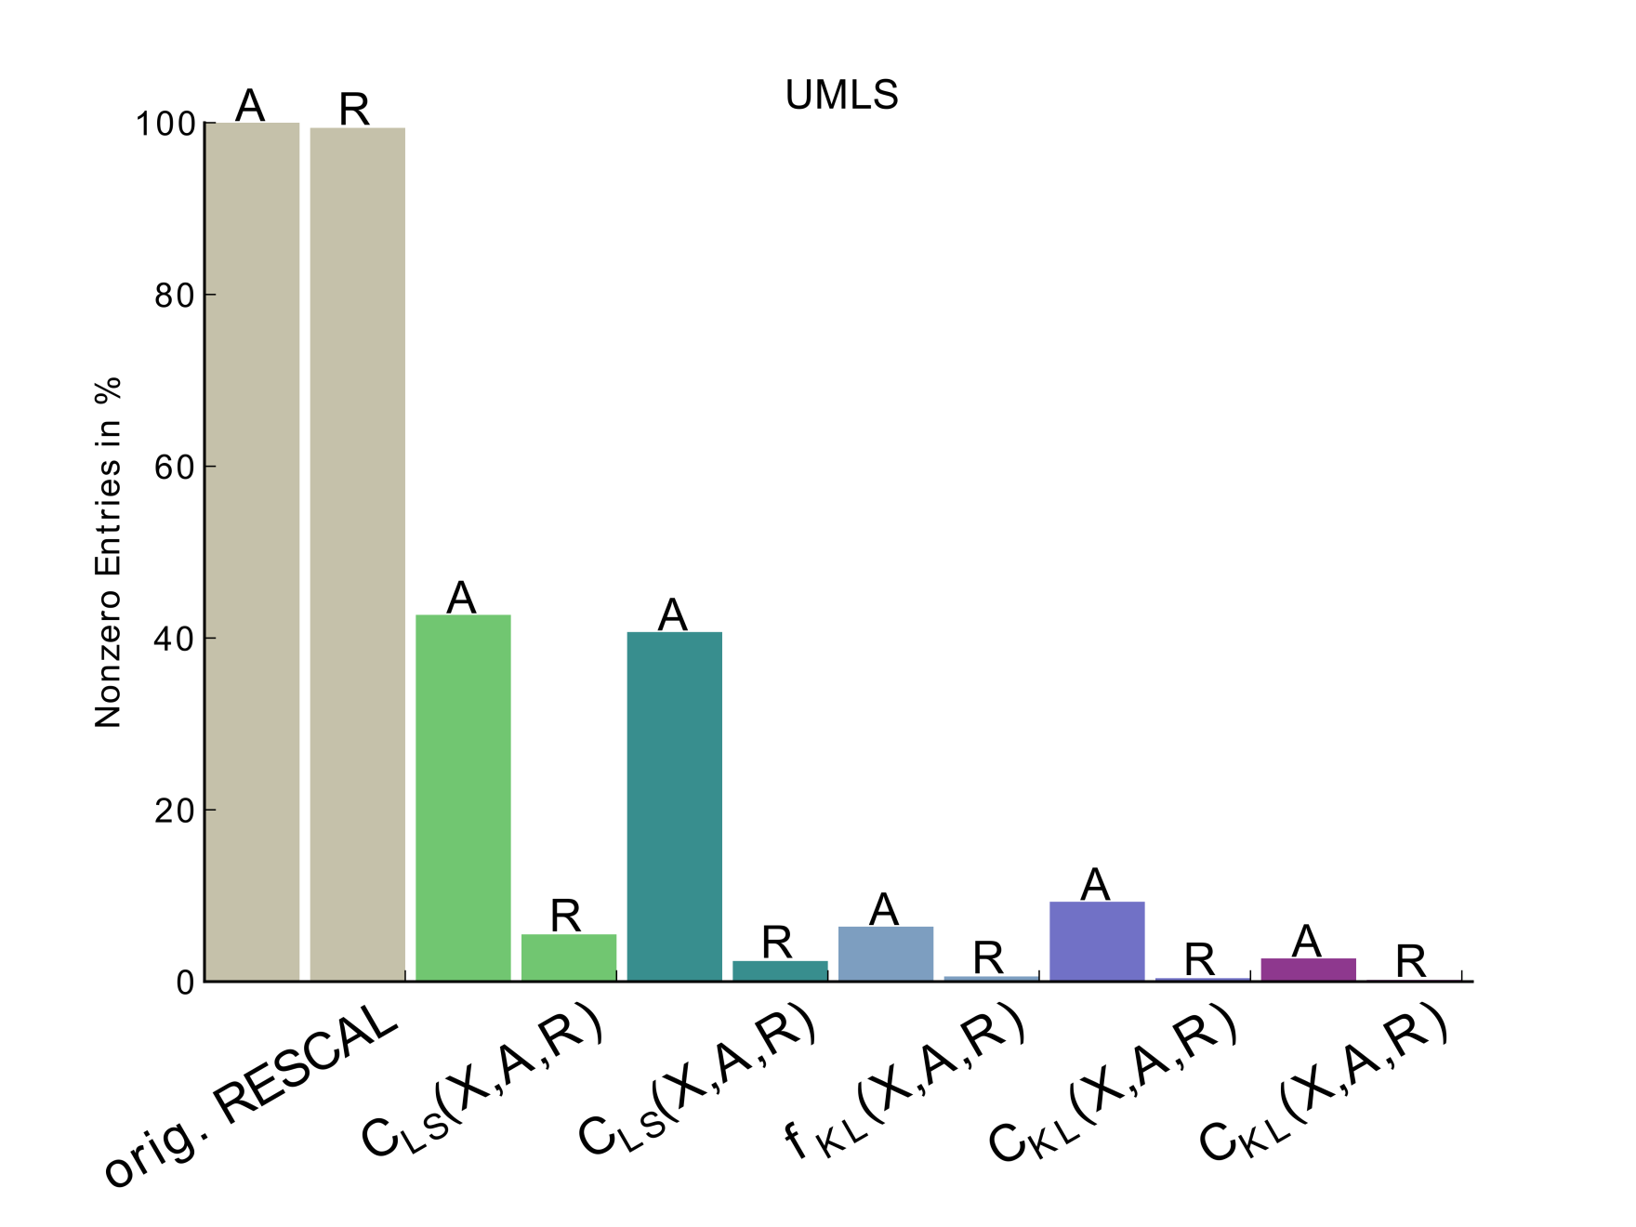
Results
In Kinships and UMLS case, the performance is similar to the original RESCAL
Worse performance on the nations dataset
Sparsity of latent factors significantly lower for UMLS and Kinships
Minimizing KL-Divergence Cost functions leads to more sparse factors
LS
KL-Divergence
LS
KL-Divergence

Slide 10
Conclusion
Extended non-negative matrix factorization to relational learning tasks with the RESCAL model employing multiplicative update rules.
Derived update rules for Least-Squares and KL-Divergence based cost functions including: Regularization, Normalization and Attribute Information
(+) Benefits:
Updates also exploit data sparsity
Little loss in predictive performance
Significant gain in sparsity of latent factor representation
(-) Drawbacks:
Slower convergence even after using non-random initialization of factor matrices as proposed by [9]

Slide 11
References
Harshman, RA: Foundations of the PARAFAC procedure: Models and conditions for an "explanatory" multi-modal factor analysis. UCLA Working Papers in Phonetics, 16, 1-84 (1970)
Carroll, JD, Chang, JJ: Analysis of individual differences in multidimensional scaling via an N-way generalization of "Eckert-Young" decomposition. Psychometrika, 35, 283-319 (1970)
Tucker, LR: Some Mathematical notes on three-mode factor analysis. Psychometrika, 31, 279-311 (1966)
Lee, DD, Seung, H.S.: Algorithms for Non-negative Matrix Factorization. In NIPS, 556-562 (2000)
Nickel, M, Tresp, V, Kriegel, HP: A Three-Way Model for Collective Learning on Multi-Relational Data. In Proceedings of the 28th International Conference on Machine Learning (2011)
Wang, F, Li, P, König, AC: Efficient Document Clustering via Online Nonnegative Matrix Factorizations In Proceedings of SDM'11, 908-919 (2011)
Kohen, Y: The BellKor Solution to the Netflix Grand Prize. (2009)
Nickel, M, Tresp, V, Kriegel, HP: Factorizing YAGO. Scalable Machine Learning for Linked Data. In Proceedings of the 21st International World Wide Web Conference (WWW2012) (2012)
Boutsidis, C, Gallopoulos, E: SVD-based initialization: A head start for nonnegative matrix factorization. Pat. Recogn. 41(4), 1350-1362 (2008)
Langville, AN, Meyer, CD, Albright R: Initializations for the Nonnegative Matrix Factorization. KDD (2006)
Lee, DD, Seung, HS: Learning the parts of objects by non-negative matrix factorization. Nature, 401, 788-791 (1999)
Mørup, M, Hanson, LK: Algorithms for Sparse Non-negative Tucker decomposition. Neural Comput. 20(8), 2112-31 (2008)
Eggert, J, Körner, E: Sparse coding and NMF. In Neural Networks, volume 4, pages 2529-2533 (2004)

