Slide 1




Large-Scale Factorization of Type-Constrained Multi-Relational Data
Denis Krompaß¹, Maximilian Nickel² and Volker Tresp^{1,3}
¹ Department of Computer Science. Ludwig Maximilian University,
² MIT, Cambridge and Istituto Italiano di Tecnologia
³ Corporate Technology, Siemens AG

Slide 2
Outline
Introduction and Motivation
  Knowledge Bases are Triple Stores
  The RESCAL Tensor Factorization for RDF-Triplestores
  Type-Constraints in Knowledge Bases
Introducing Type-Constraints into RESCAL
Experimental Results (DBpedia)

Slide 3
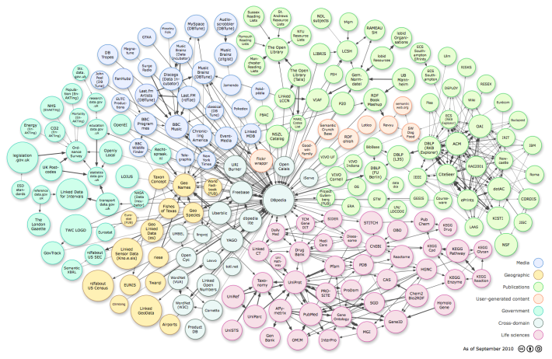

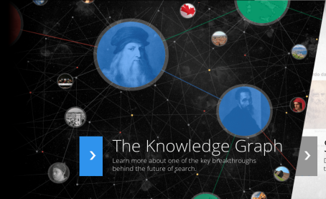
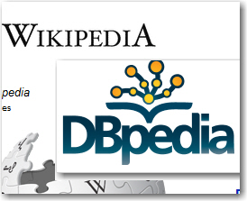

Knowledge Bases are Triple Stores
Represents facts of the world in a machine readable form
e.g.:
(Jack, likes,Lucy)
(Jack, isfriendOf,Jim)
(ACDC, genre,Rock)
SUBJECT
PREDICATE
OBJECT
+
-
Machine Readable
Utilize Background Knowledge in Applications
Provide Additional Information (Search)
Incomplete
Contains also False Facts
Only a few attempts that provide information about triple uncertainty

Slide 4
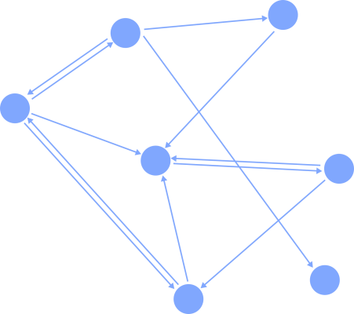
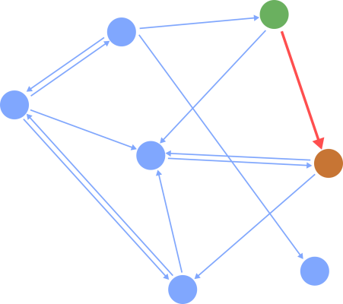
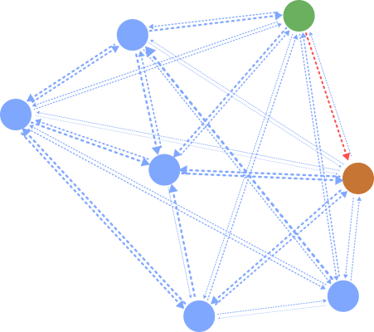
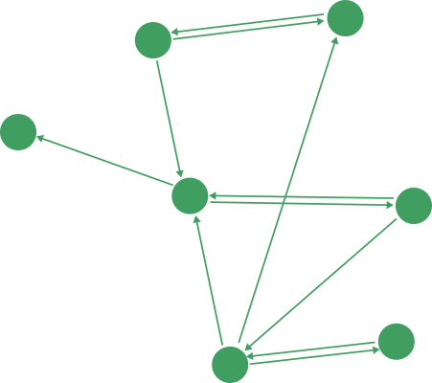
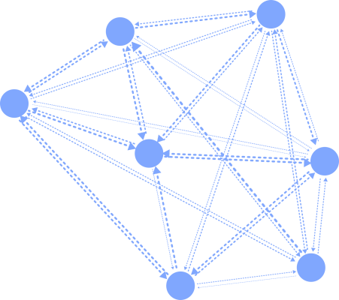
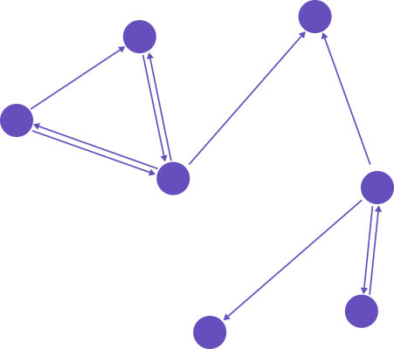
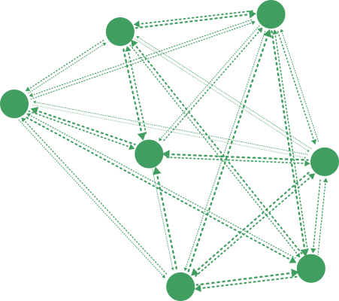
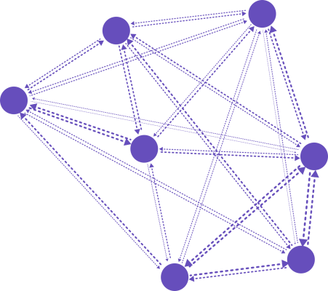
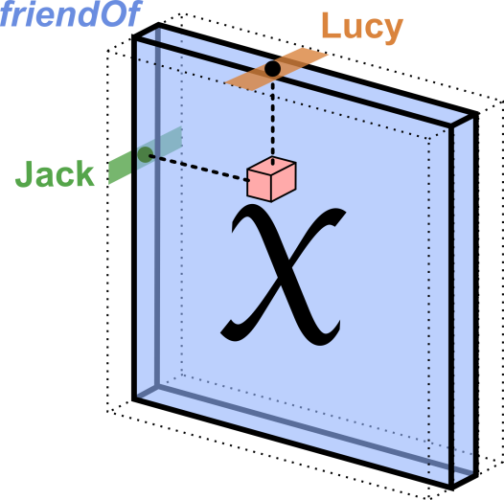
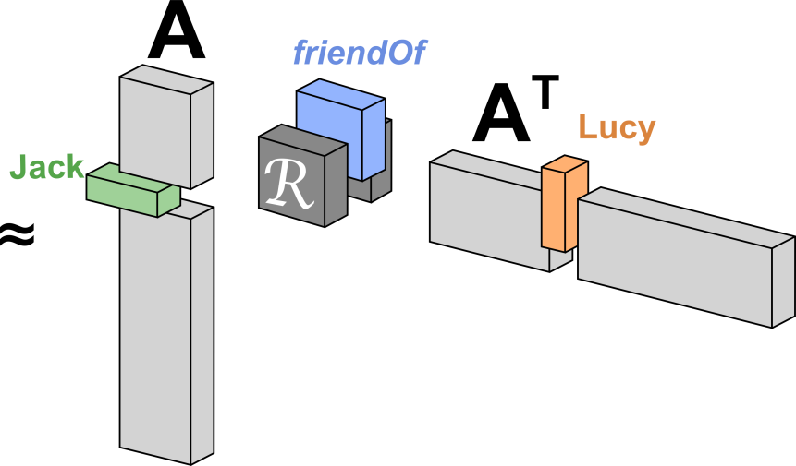
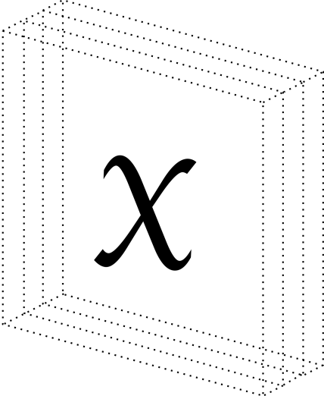
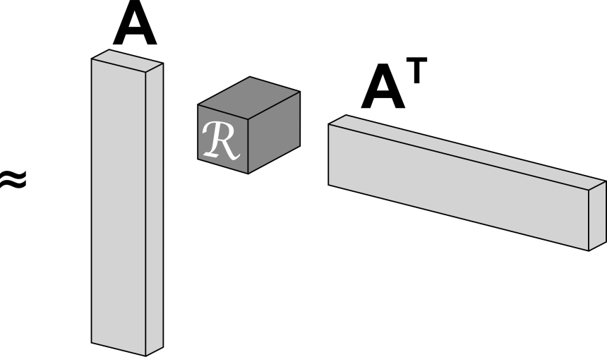
RESCAL Tensor Factorization for Multi-Relational (Triple-)Data
Jane
Jack
Jack
Jane
friendOf:
John | Frank | 0.92
Jane | Jim | 0.91
Mike | Jane | 0.85
Frank | John | 0.73
Jane | John | 0.58
Jim | Lucy | 0.37
Jack | Lucy | 0.34
Lucy | Jim | 0.31
… | … | …
John
Lucy
Lucy
John
Jim
Jim
Frank
Mike
Mike
Frank
Adjacency Tensor

Slide 5
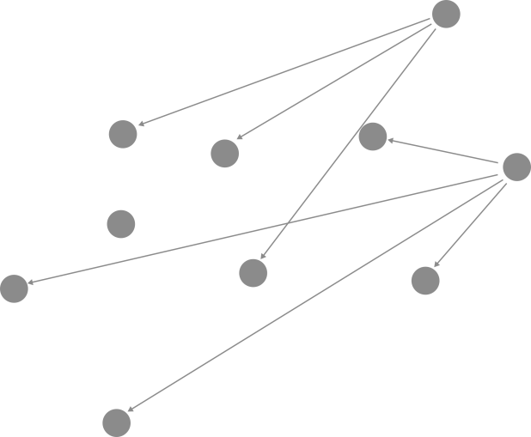

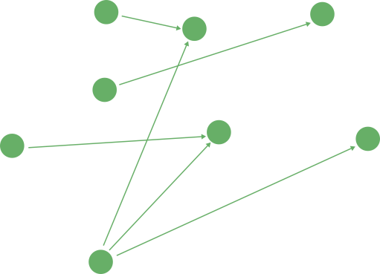
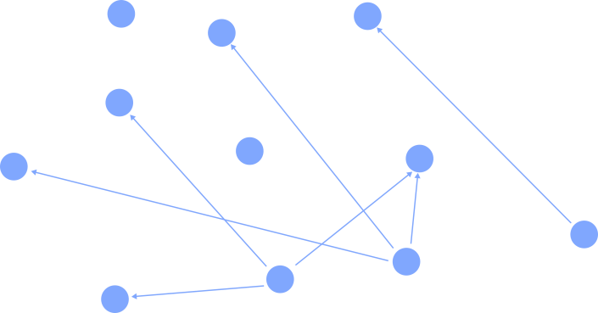
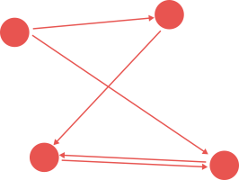
Type-Constraints in Knowledge Bases
RESCAL Assumption
Knowledge Base Data
Entity 7
Entity 1
Entity Set 2
Entity Set 3
Entity 6
Entity 2
Entity Set 1
Entity 5
Entity 4
Entity 3
Entity Set 4
All entities participate in all relation types
Relation Types incorporate only subsets of entities

Slide 6
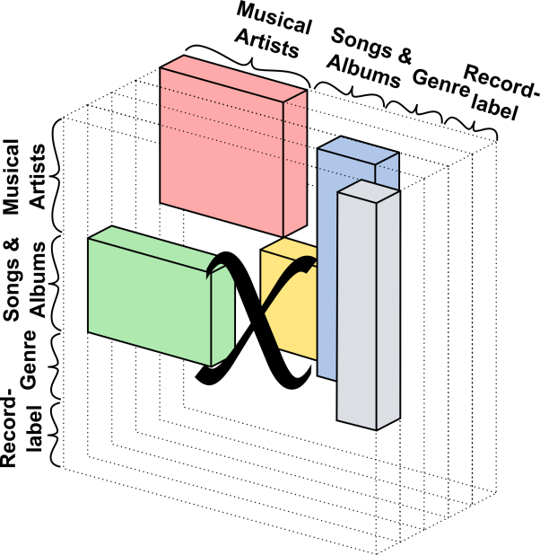
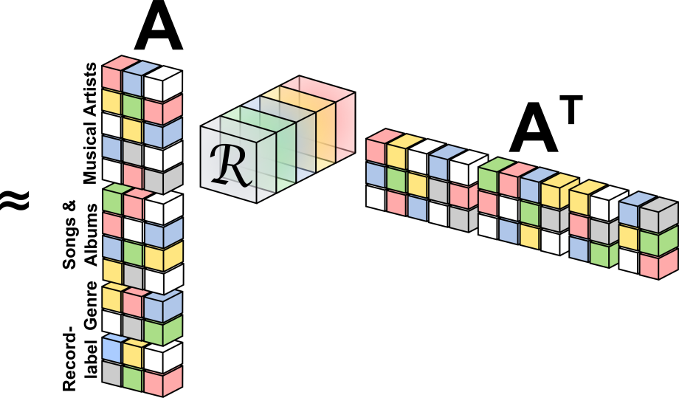
Local Closed-World Assumptions
Large Knowledge Bases contain hundreds of relation types
Most of relation types relate only subsets of entities present in the KB
  Local Closed World Assumptions (LCA)
  (Nickelback,genre,Rock)
  (Nickelback,genre,ACDC)
  Type Constraints for Relation Types
RESCAL does not support Type Constraints
Record Labels
Songs &
Albums
Musical Artists
√
Genres

Slide 7
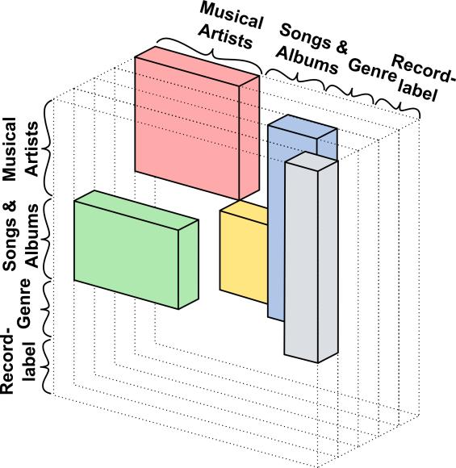
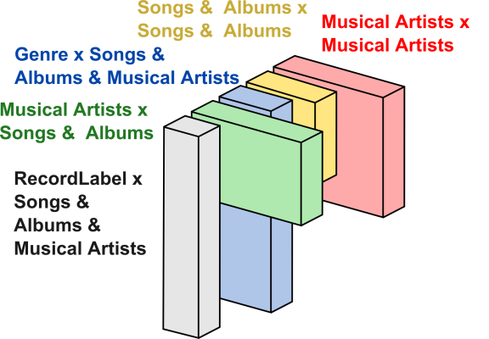
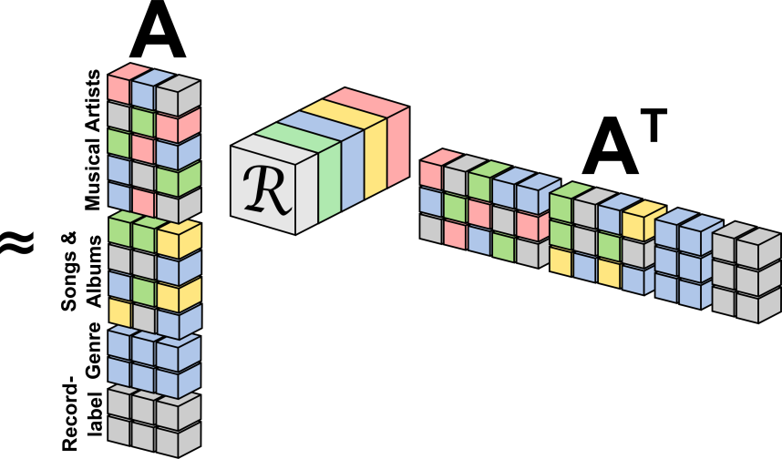
Exploiting Type-Constraints in RESCAL
Factor Selection Matrices (Type Constraints)
Type Constraints (Ŝ and Ô):
  Given by the Knowledge Base
  Or can be approximated with the observed data
X

Slide 8
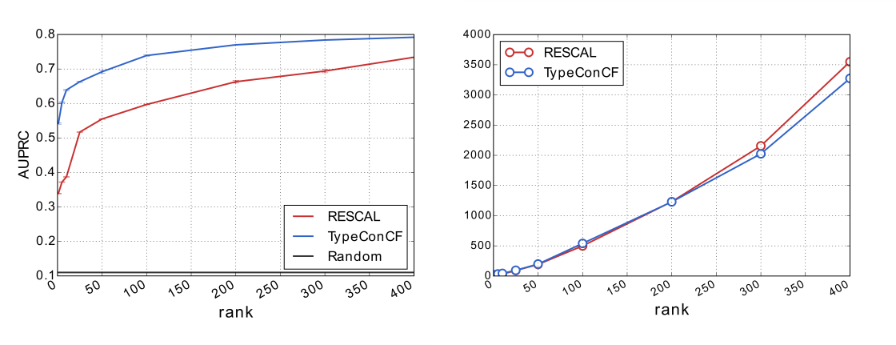
Factorizing DBpedia-Music for Link Prediction
Mapping-Based Properties (Cleaned)
(311k Entities, 7 Relation Types, 1 Million Triples)
On a medium sized Dataset:
  Similar Runtime same model complexity (rank) & higher prediction quality.
  Similar prediction quality lower Model Complexity & Runtime
RESCAL
1 hour
RESCAL+
Type Constraints
Time (s)
AUPRC: 0.73
9 Minutes

Slide 9
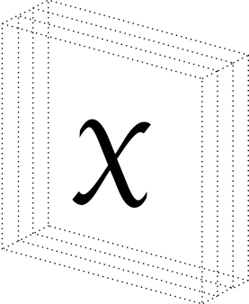
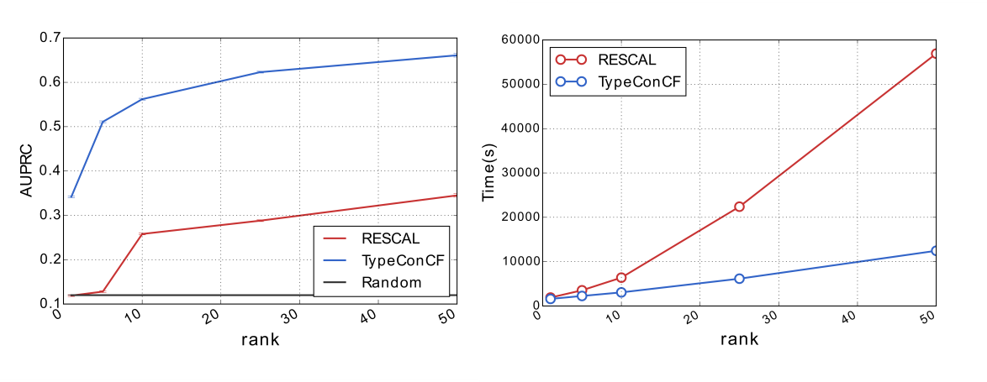
Factorizing DBpedia for Link Prediction
Mapping-Based Properties (Cleaned)
(2.2 Million Entities, 511 Relation Types,17 Million Triples)
511
Sparsity: 6.52 x 10⁻⁹
Performance (prediction quality and runtime) is improved especially for large multi-relational datasets
2.2 million
2.2 million
~16h,
low quality
~3h,
good quality
AUC: 0.84
Very Low Rank = Low Memory Costs
On a Regular
Laptop

Slide 10
Summary
Considering Local Closed-World Assumptions is important in large Type-Constraint multi relational datasets like DBpedia.
LCAs can be introduced into the RESCAL model through type-constraints.
RESCAL with type constraints clearly outperforms RESCAL without type-constraints on large type-constrained multi-relational datasets like DBpedia.

Slide 11
Questions?
http://www.dbs.ifi.lmu.de/~krompass/
Denis.Krompass@campus.lmu.de
Python code is available.

