Slide 1
Probabilistic Latent-Factor Database Models
Denis Krompaß¹, Xueyan Jiang¹ ,Maximilian Nickel² and Volker Tresp^{1,3}
¹ Department of Computer Science. Ludwig Maximilian ²University, Oettingenstraße 67, 80538 Munich, Germany
MIT, Cambridge, MA and Istituto Italiano di Tecnologia, Genova, Italy
³ Corporate Technology, Siemens AG, Otto-Hahn-Ring 6, 81739 Munich, Germany

Slide 2
Outline
Knowledge Bases Are Triple Graphs
Link/Triple Prediction With RESCAL
Probabilistic Database Models
Querying Factorized Multi-Graphs
Including Local Closed World Assumptions
Conclusion

Slide 3
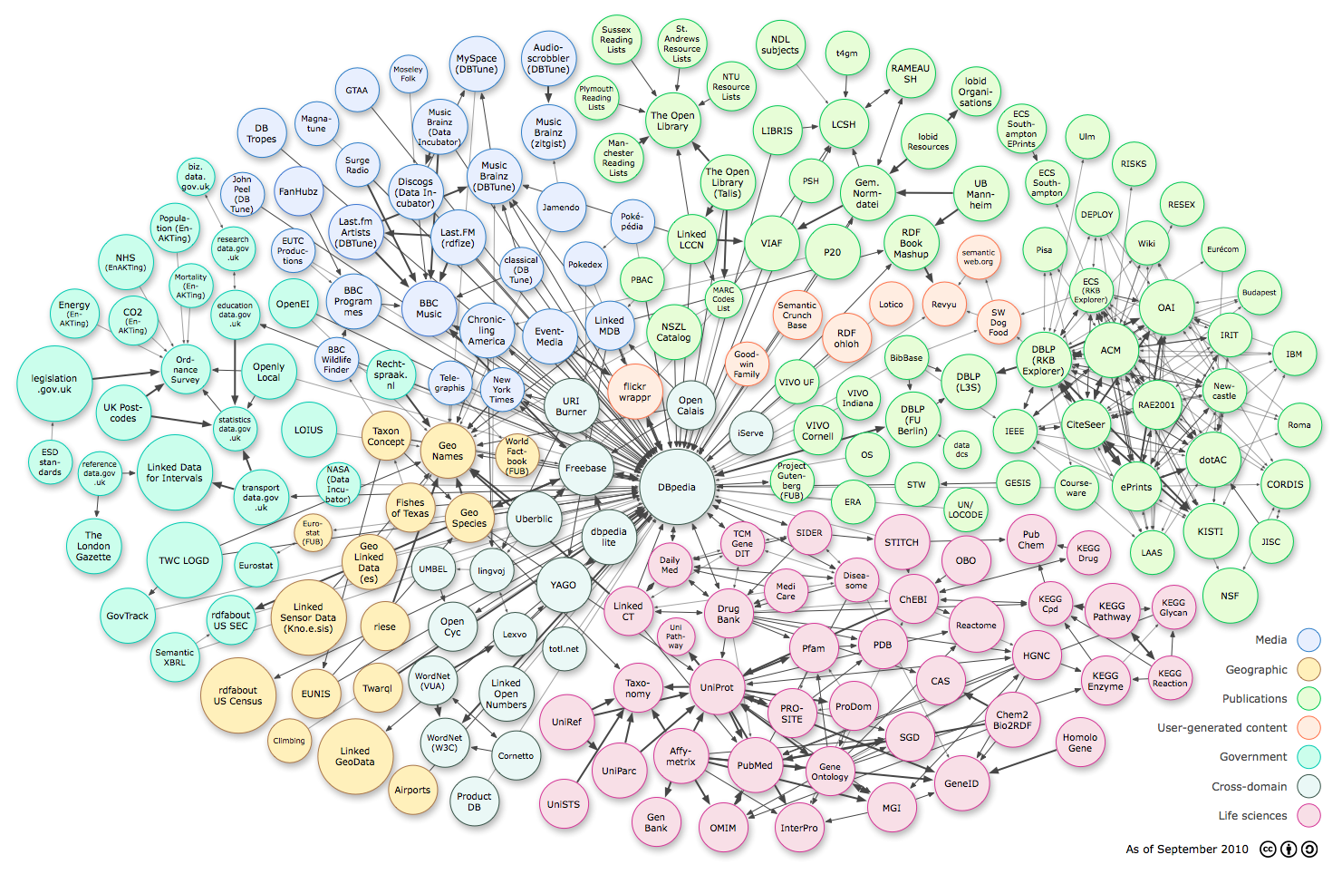
Knowledge Bases are Triple Graphs
Linked Open Data (LOD) and large ontologies like DBpedia, Yago, Knowledge Graph are graph-based knowledge representations using light-weight ontologies, and are accessible to machine learners
Millions of entities, hundreds to thousands of relations
Millions to billions of facts about the world

Slide 4
Knowledge Bases are Triple Graphs
Linked Open Data (LOD) and large ontologies like DBpedia, Yago, Knowledge Graph are graph-based knowledge representations using light-weight ontologies, and are accessible to machine learners
Millions of entities, hundreds to thousands of relations
Millions to billions of facts about the world
They are all triple oriented and more or less follow the RDF standard
RDF: Resource Description Framework

Slide 5
Knowledge Bases are Triple Graphs
Linked Open Data (LOD) and large ontologies like DBpedia, Yago, Knowledge Graph are graph-based knowledge representations using light-weight ontologies, and are accessible to machine learners
Millions of entities, hundreds to thousands of relations
Millions to billions of facts about the world
They are all triple oriented and more or less follow the RDF standard
RDF: Resource Description Framework
Goal in Triple oriented Database is to predict the existence of a triple (new links in the graph)

Slide 6
Knowledge Bases are Triple Graphs
Linked Open Data (LOD) and large ontologies like DBpedia, Yago, Knowledge Graph are graph-based knowledge representations using light-weight ontologies, and are accessible to machine learners
Millions of entities, hundreds to thousands of relations
Millions to billions of facts about the world
They are all triple oriented and more or less follow the RDF standard
RDF: Resource Description Framework
Goal in Triple oriented Database is to predict the existence of a triple (new links in the graph)
Recent application: Google Knowledge Vault (Dong et al.)

Slide 7
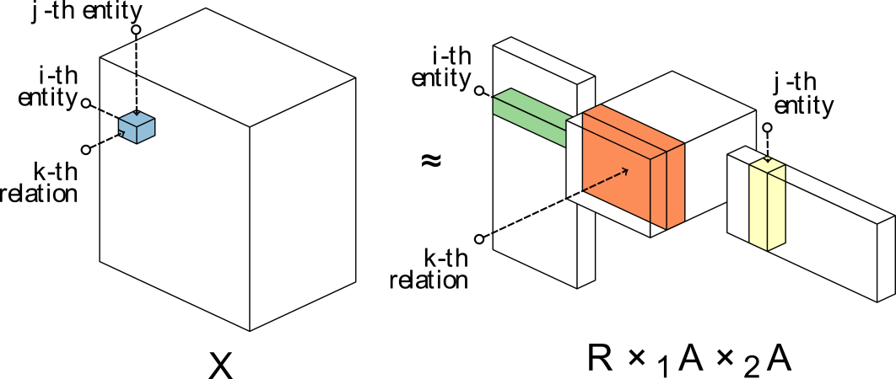
Triple Prediction with RESCAL
e.g. marriedTo(Jack,Jane)
Nickel et al. ICML 2011, WWW 2012

Slide 8
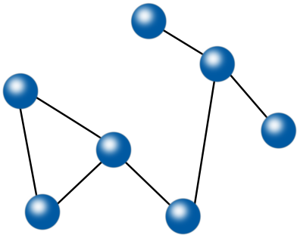
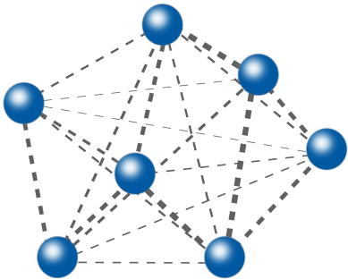
Triple Prediction with RESCAL
e.g. marriedTo(Jack,Jane)
Nickel et al. ICML 2011, WWW 2012
e₂
e₂
e₃
e₁
e₃
r_{k}(e₃,e₅)
r_{k}(e₂,e₃)
r_{k}(e₆,e₅)
…
e₁
Relation r_{k}
Relation r_{k}
e₆
e₄
e₆
e₄
e₇
e₅
e₇
e₅
ranking

Slide 9
Probabilistic Database Models
In some Data, quantities are attached to the links:
Rating of an user for a movie
The amount of times team A played against team B
Amount of medication for a patient
Binary Data
Count Data
Model | Nations | Kinship | UMLS
RESCAL | 0.843 | 0.962 | 0.986
Bernoulli | 0.850 | 0.980 | 0.986
Poisson | 0.847 | 0.981 | 0.967
Multinomial | 0.659 | 0.976 | 0.922
Model | Nations | Kinship | UMLS
RESCAL | 0.627 | 0.949 | 0.795
Binomial | 0.637 | 0.950 | 0.806
Poisson | 0.632 | 0.952 | 0.806
Multinomial | 0.515 | 0.951 | 0.773
RESCAL-P | 0.638 | 0.951 | 0.806

Slide 10
Local Closed World Assumptions
Large Knowledge Bases contain hundreds of relation types
Most of relation types only relate only subsets of entities present in the KB
Local Closed World Assumptions (LCA)
marriedTo(Jack,Jane)
marriedTo(Cat,Rome)
Type Constraints for Relation Types
√

Slide 11
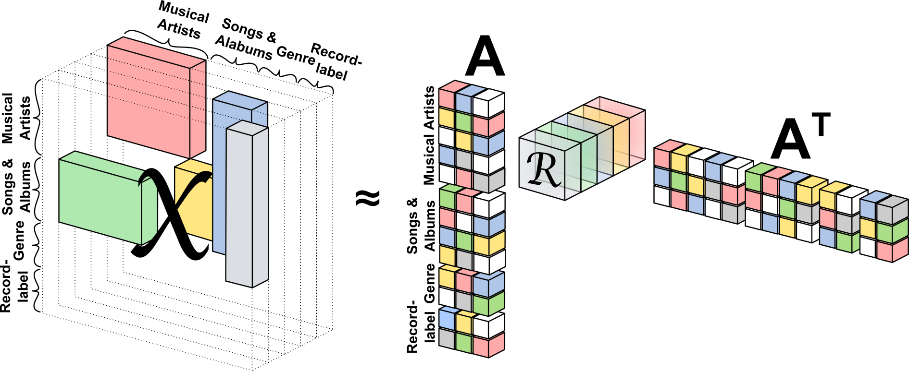
Local Closed World Assumptions
Large Knowledge Bases contain hundreds of relation types
Most of relation types only relate only subsets of entities present in the KB
Local Closed World Assumptions (LCA)
marriedTo(Jack,Jane)
marriedTo(Cat,Rome)
Type Constraints for Relation Types
RESCAL does not support Type Constraints
√

Slide 12
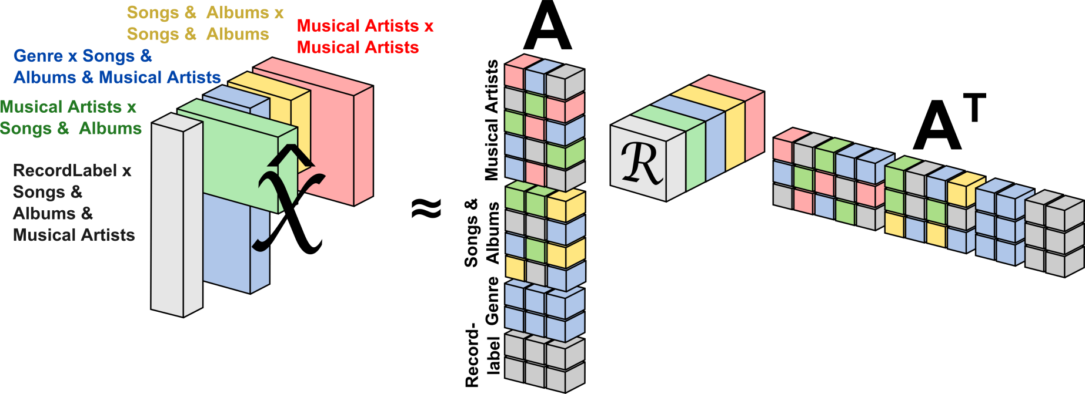
Exploiting Type Constraints
Type Constraints can be introduced into the RESCAL factorization (Krompaß et al. DSAA 2014)
Type Constraints:
Given by the Knowledge Base
Or can be approximated with the observed data

Slide 13
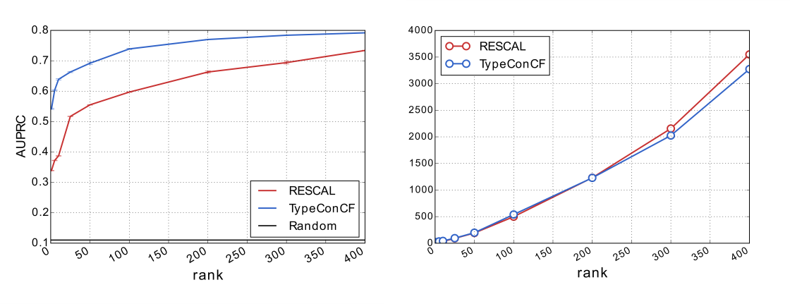
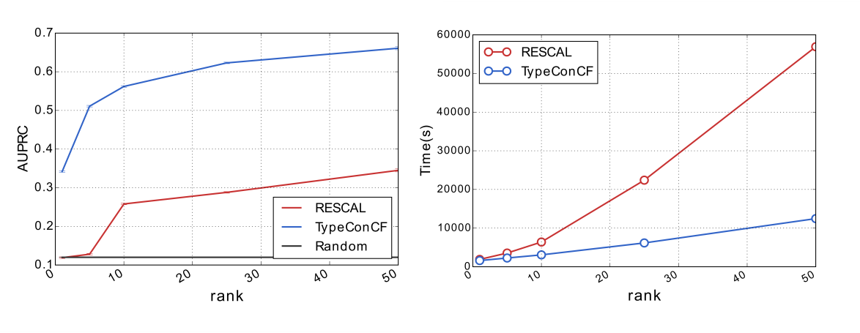
Exploiting Type Constraints
Performance (prediction quality and runtime) is improved especially for large multi-relational datasets
RESCAL
DBpedia-Music
311,474 Entities,
7 Relation Types,
1,006,283 triples
RESCAL+
Type Constraints
DBpedia
2.255.018 Entities,
511 Relation Types,
16,945,046 triples,
Sparsity: 6.52 × 10⁻⁹

Slide 14
Querying Factorized Knowledge Bases
Probabilities of single triples can be inferred through RESCAL
Exploit theory of probabilistic databases for complex querying
Problem:
Extensional Query Evaluation can be very slow
(even though it has polynomial time complexity)
Krompaß et al. ISWC 2014 (Best Research Paper Nominee)
We approximate views generated by independent project rules
We are able to construct factorized views which are very memory efficient

Slide 15
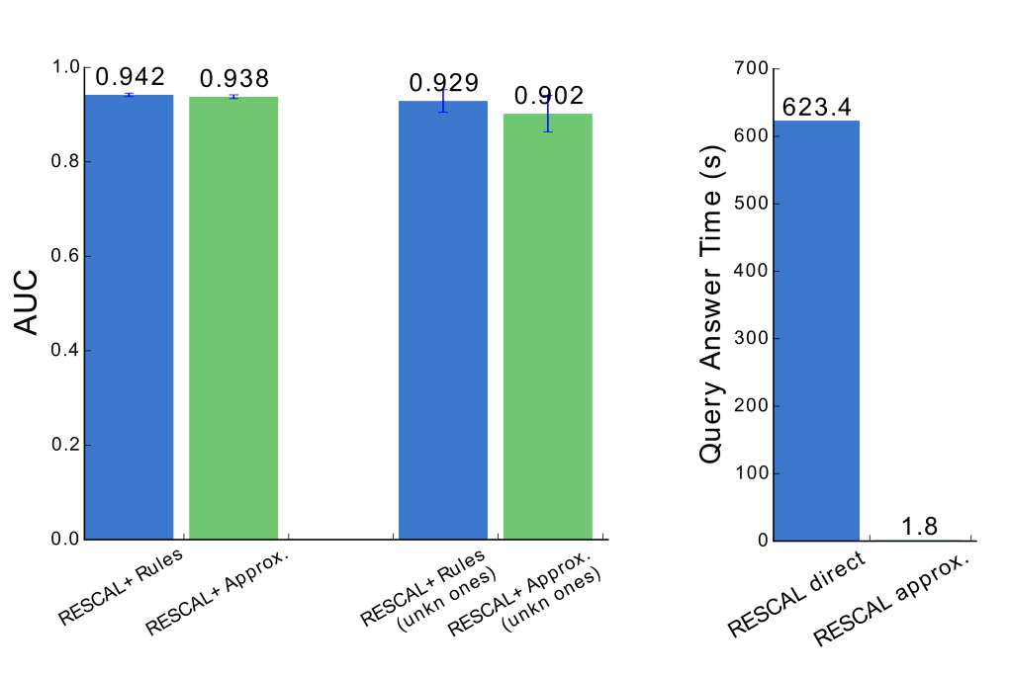
Querying Factorized Knowledge Bases
„Which musical artists from the Hip Hop music genre have/had a contract with Shady, Aftermath or Death Row records?”

Slide 16
Higher Order Relations
In principle, we are not restricted to binary relations
Binary Relations:
N-ary Relations

Slide 17
Conclusion
When the data is complete and sparse, RESCAL Gaussian likelihood is most efficient
Applicable to binary and count data
The Gaussian likelihood model can compete with the more elegant likelihood cost functions
Model complexity can be reduced by considering Type Constraints

Slide 18
Questions?

