Slide 1
1st International ACM SIGMOD Workshop on Managing and Mining Enriched Geo-Spatial Data
Snowbird 2014

Slide 2
What is GeoRich about?
The aim of this workshop is to provide a unique forum for discussing in depth the challenges, opportunities, novel techniques and applications on modeling, managing, searching and mining rich geo-spatial data, in order to fuel scientific research on big spatial data applications beyond the current research frontiers.

Slide 3
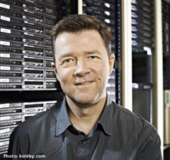
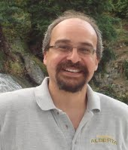
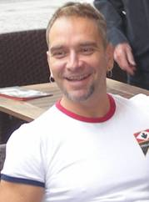
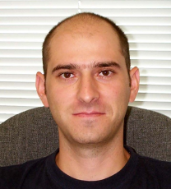
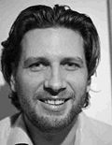
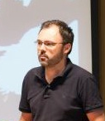
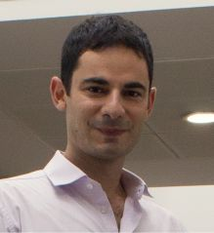
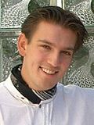
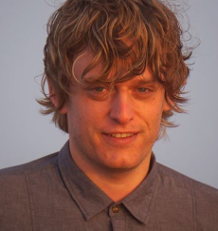
Steering Committee and Chairs
PC Chair
PC Chair
PC Chair

Slide 4
Organizing Committee
Proceedings Chair
Leong Hou U (University of Macau, China) Publicity Chair
Panagiotis Bouros (Humboldt-Universität zu Berlin, Germany) Webmaster
Johannes Niedermayer (Ludwig-Maximilians University Munich, Germany)
Programm Committee
Farnoush Banaei-Kashani (University of Southern California, USA) Panagiotis Bouros (Humboldt-Universität zu Berlin, Germany) Muhammad Cheema (University of New South Wales, Sydney) Lei Chen (Hong Kong University of Science and Technology) Reynold Cheng (University of Hong Kong) Max Egenhofer (University of Maine, USA) Christian Freksa (University of Bremen, Germany) Michael Gertz (Heidelberg University, German)y Gabriel Ghinita (University of Massachusetts, USA) Ralf Hartmut Güting (Fernuniversität Hagen, Germany) Erik Hoel (ESRI) Werner Kiessling (University of Augsburg, Germany) Peer Kröger (Ludwig-Maximilians University Munich, Germany) Feifei Li (University of Utah, USA) Xue Li (School of ITEE, Austraila)
Hua Lu (Aalborg University, Denmark) Mohamed Mokbel (University of Minnesota, USA) Silvia Nittel (University of Maine, USA) Dimitris Papadias (Hong Kong University of Science and Technology) Spiros Papadimitriou (Rutgers University, USA) Stavros Papadopoulos (Hong Kong University of Science and Technology) Dieter Pfoser (George Mason University, USA) Dimitris Sacharidis(Institute for the Management of Information Systems, RC Athena) Markus Schneider (University of Florida, USA) Erich Schubert (Ludwig-Maximilians University Munich, Germany) Matthias Schubert (Ludwig-Maximilians University Munich, Germany) Bernhard Seeger (University of Marburg, Germany) Thomas Seidl (RWTH Aachen University, Germany) Yufei Tao (Chinese University of Hong Kong) Manolis Terrovitis (Institute for the Management of Information Systems, RC Athena) Goce Trajcevski (Northwestern University, USA) Ouri Wolfson (University of Illinois, USA) Raymond Chi-Wing Wong (Hong Kong University of Science and Technology) Ke Yi (Hong Kong University of Science and Technology) Man Lung Yiu (Hong Kong Polytechnic University) Xiaofang Zhou (University of Queensland, Australia) Arthur Zimek (Ludwig-Maximilians University Munich, Germany)

Slide 5
Statistics
PC Members: 41 (+10 external)
Submissions: 18
Avg. # of reviews/paper: 3.72
Accepted: 8
Acceptance rate: 44%

Slide 6
PC Members
1
13
1
8
2
12
1
3

Slide 7
Authorship
3
4(NL)
3
1
1(FR)
1
4
7(DE)
4
20
3

Slide 8
Program
From To Program
8:30 8:35 Welcome
8:35 9:30 Keynote by Krzysztof Janowicz
9:30 10:00 Poster Session
10:00 10:30 Coffee Break
10:30 12:00 Paper Session: Scientific and Social Enrichment of Geo-Spatial Data
12:00 13:30 Lunch Break (on your own)
13:30 15:00 Paper Session: Textual and Semantic Enrichment of Geo-Spatial Data
15:00 15:45 Coffee Break
15:45 16:45 Paper Session: Multi-Source Enrichment of Geo-Spatial Data
16:45 18:00 Break
18:00 Participants Dinner (on your own)

Slide 9
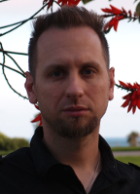
Keynote
The Why, What, and How of Geo-Information Observatories
Krzysztof Janowicz,
Assistant Professor for Geographic Information Science and Geoinformatics
University of California, Santa Barbara, USA

