Slide 1




Managing Uncertainty in
Spatial and Spatio-temporal Data
Andreas Züfle¹, Goce Trajcevski², Tobias Emrich?
Matthias Renz¹, Hans-Peter Kriegel¹, Nikos Mamoulis³, Reynold Cheng³
¹ LMU Munich
² NWU Evanston
³ HKU Hong Kong
⁴ USC Los Angeles

Slide 2
Managing Uncertainty in
Spatial and Spatio-temporal Data
?
?
?
Andreas Züfle¹, Goce Trajcevski², Tobias Emrich?
Matthias Renz¹, Hans-Peter Kriegel¹, Nikos Mamoulis³, Reynold Cheng³
¹ LMU Munich
² NWU Evanston
³ HKU Hong Kong
⁴ USC Los Angeles

Slide 3


Slide 4
Aim of this tutorial …
Understand basic concepts for scalable probabilistic query processing on uncertain spatial and spatio-temporal query processing.
A tutorial, not a survey.
Get the big picture …
  NOT in terms of a long list of recent methods and algorithms
  BUT in terms of general concepts, commonly used in this field.

Slide 5
Outline
Tutorial decomposed into three parts:
  Uncertain Spatial Data (Andreas Züfle)
  Uncertain Spatio-Temporal Data (Geometric Approach) (Goce Trajcevski)
  Uncertain Spatio-Temporal Data (Probabilistic Approach) (Tobias Emrich)
Please feel free to ask questions at any time during the presentation.
The latest version of these slides will be made available within the next week:
http://www.dbs.ifi.lmu.de/~zuefle

Slide 6

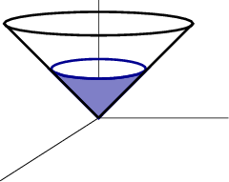
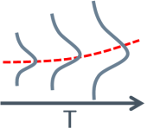
Outline
Introduction
Uncertain Spatial Data
Uncertain Spatio-Temporal Data
(Geometric Approach)
Uncertain Spatio-Temporal Data
(Probabilistic Approach)

Slide 7
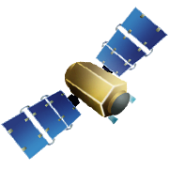






Geo-Spatial Data
Huge flood of geo-spatial data
  Modern technology
  New user mentality
Great research potential
  New applications
  Innovative research
  Economic Boost
    “$600 billion potential annual consumer surplus from using personal location data” [1]
[1] McKinsey Global Institute. Big data: The next frontier for
innovation, competition, and productivity. June 2011.

Slide 8
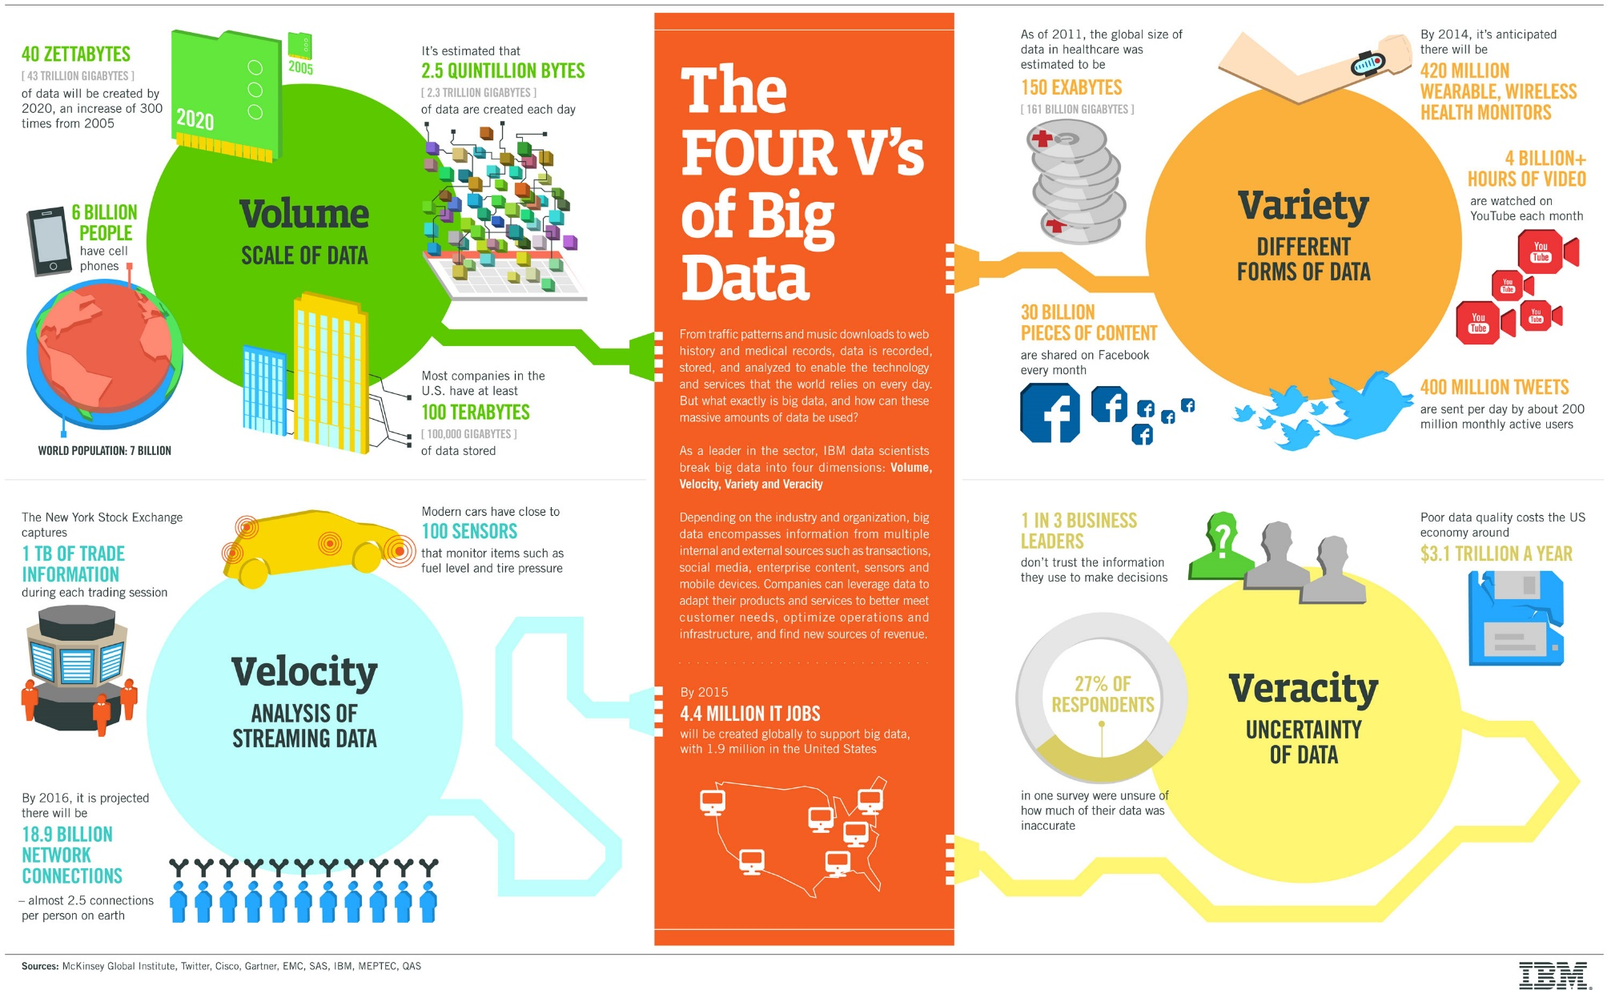
Geo-Spatial Data

Slide 9
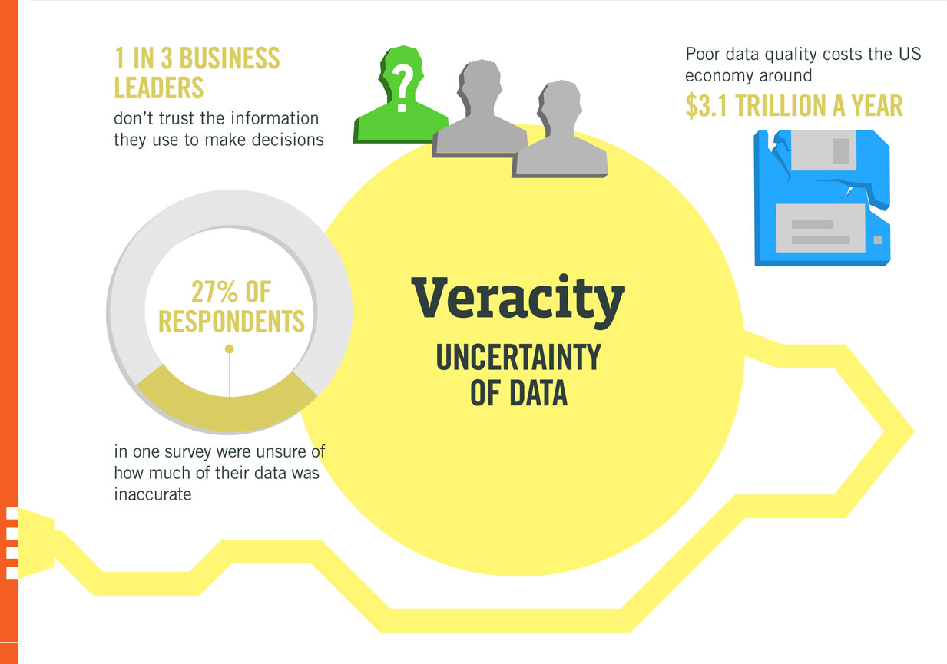

Slide 10
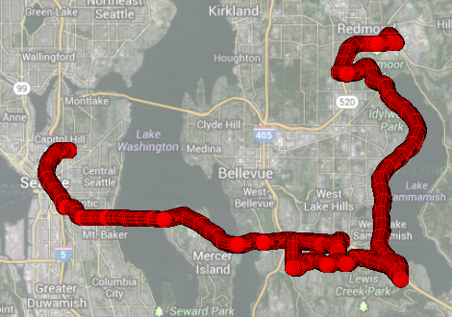
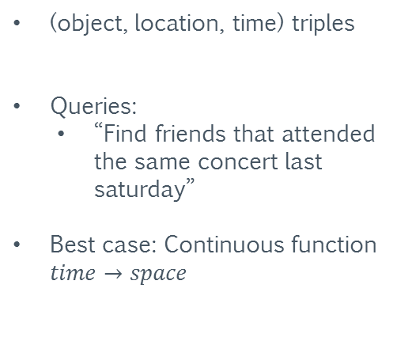
Spatio-Temporal Data
(object, location, time) triples
Queries:
  “Find friends that attended the same concert last saturday”
Best case: Continuous function $time→space$
GPS log taken from a thirty minute drive through Seattle
Dataset provided by: P. Newson and J. Krumm. Hidden Markov Map Matching Through Noise and Sparseness. ACMGIS 2009.

Slide 11
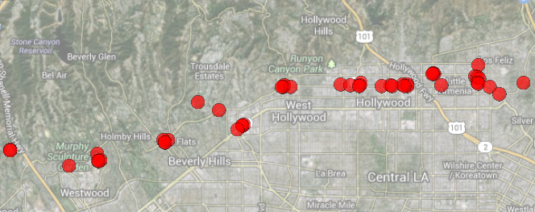
Sources of Uncertainty
Missing Observations
  Missing GPS signal
  RFID sensors available in discrete locations only
  Wireless sensor nodes sending infrequently to preserve energy
  Infrequent check-ins of users of geo-social networks
Dataset provided by: E. Cho, S. A. Myers and J. Leskovek. Friendship and Mobility: User Movement in Location-Based Social Networks. SIGKDD 2011.

Slide 12
Sources of Uncertainty
Uncertain Observations
  Imprecise sensor measurements (e.g. radio triangulation, Wi-Fi positioning)
  Inconsistent information (e.g. contradictive sensor data)
  Human errors (e.g. in crowd-sourcing applications)
From database perspective, the position of a mobile object is uncertain
Dataset provided by: E. Cho, S. A. Myers and J. Leskovek. Friendship and Mobility: User Movement in Location-Based Social Networks. SIGKDD 2011.

Slide 13
Research Challenge
Include the uncertainty, which is inherent in spatial and spatio-temporal data, directly in the querying and mining process.

Slide 14
Research Challenge
Include the uncertainty, which is inherent in spatial and spatio-temporal data, directly in the querying and mining process.
Assess the reliability of similarity search and data mining results,
enhancing the underlying decision-making process.

Slide 15
Research Challenge
Include the uncertainty, which is inherent in spatial and spatio-temporal data, directly in the querying and mining process.
Assess the reliability of similarity search and data mining results,
enhancing the underlying decision-making process.
Improve the quality of modern location based applications and of research results in the field.

Slide 16
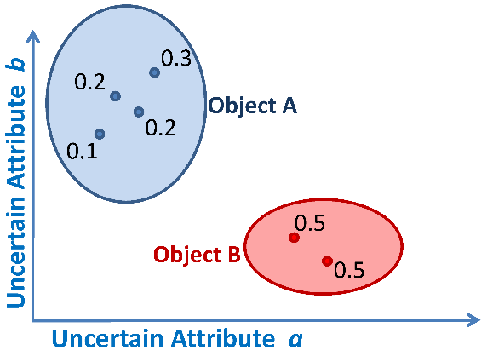
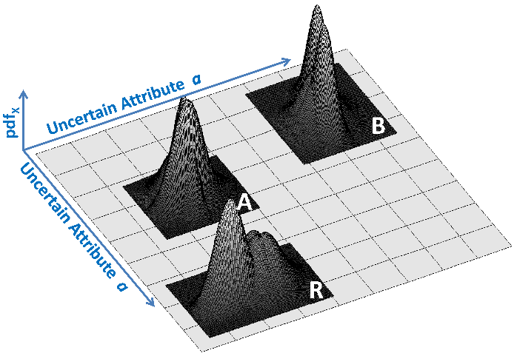
Uncertain Spatial Data: Models
Possible World Semantics
Discrete Models
Continuous Models
0.4
b

Slide 17
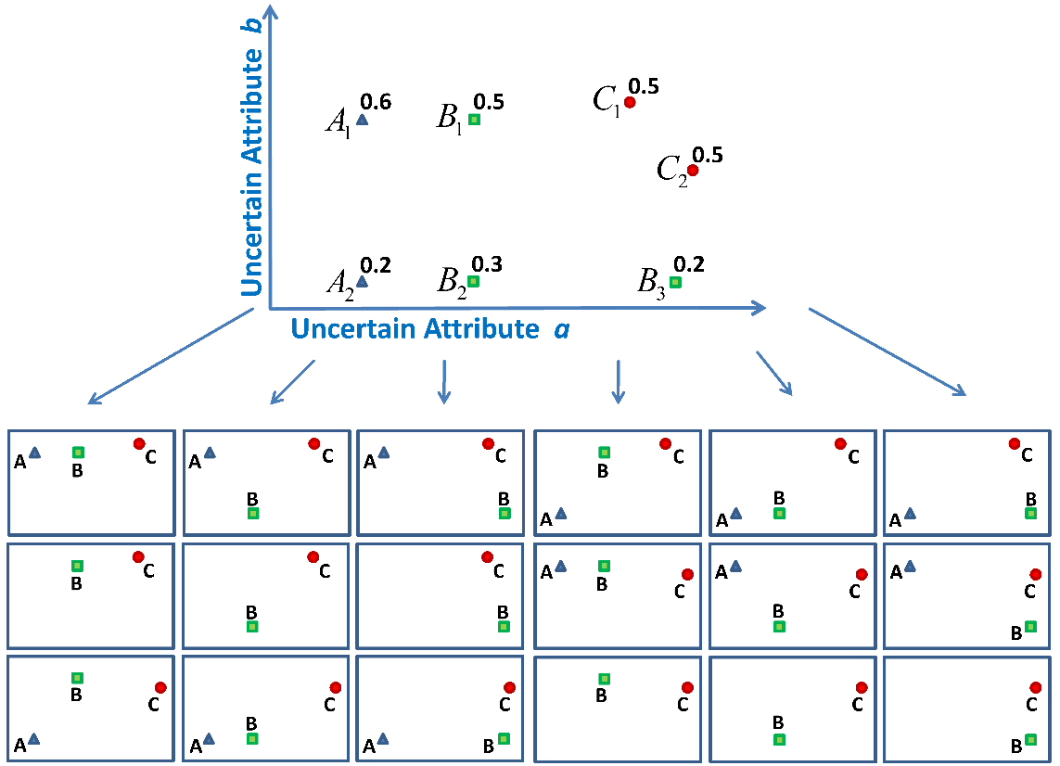
Possible World Semantics
Possible World Semantics
A collection of uncertain spatial objects defines an uncertain spatial database.
Combinations of object instances define possible database instances, called
Possible Worlds.
Assumption: The probability of a possible world can be computed efficiently.

Slide 18
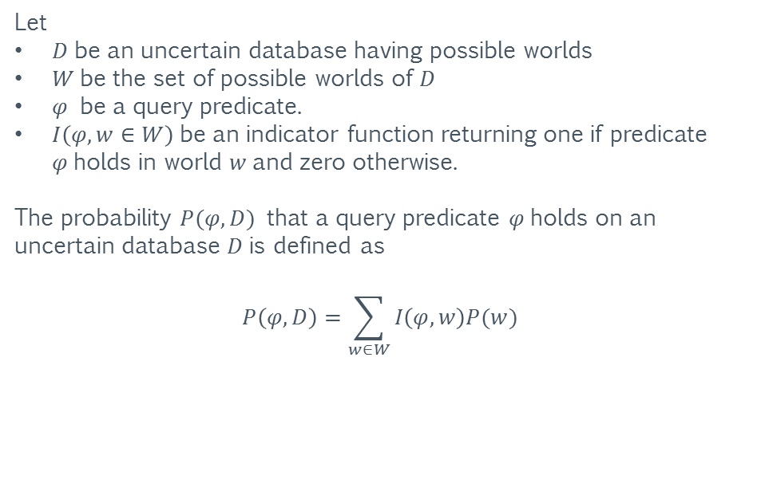
Answering Queries using PWS
Possible World Semantics
Let
$D$be an uncertain database having possible worlds
$W$be the set of possible worlds of $D$
$φ$ be a query predicate.
$I\left(φ,w∈W\right)$be an indicator function returning one if predicate $φ$holds in world $w$and zero otherwise.
The probability $P(φ,D)$ that a query predicate $φ$holds on an uncertain database $D$is defined as
$$P\left(φ,D\right)=\sum_{w∈W}{I\left(φ,w\right)P(w)}$$

Slide 19
Possible Worlds: Example II
A
B
C
D
E
F
L
H
I
G
J
K
Q
N
O
R
S
P
T
M
U
W
Z
V
X
Y

Slide 20
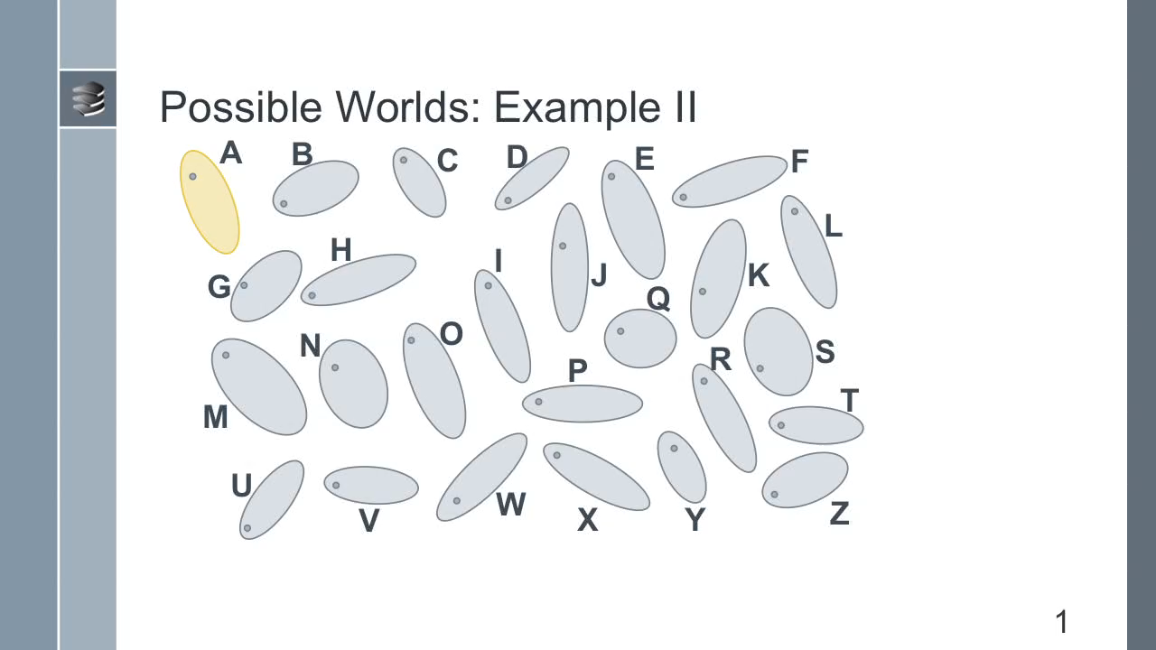
Possible Worlds: Example II
A
B
C
D
E
F
L
H
I
G
J
K
Q
N
O
R
S
P
T
M
U
W
Z
V
X
Y

Slide 21

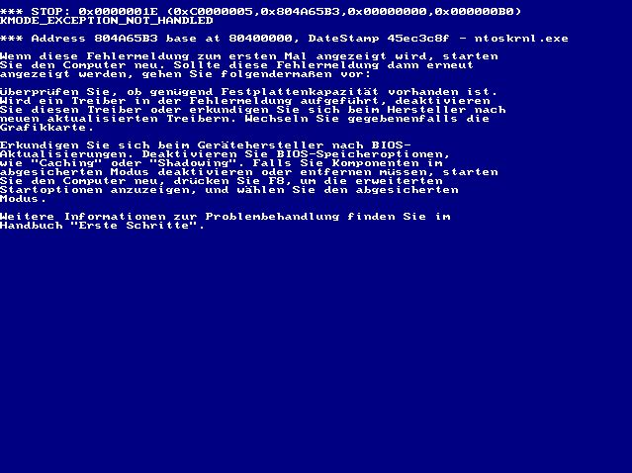

Slide 27
Too many possible worlds

Slide 28
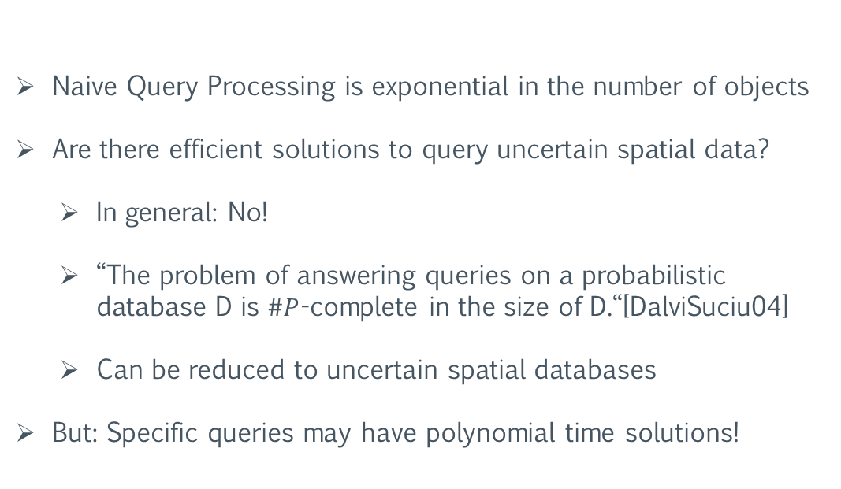
Querying Uncertain Data: Complexity
Naive Query Processing is exponential in the number of objects
Are there efficient solutions to query uncertain spatial data?
  In general: No!
  “The problem of answering queries on a probabilistic database D is $\#P$-complete in the size of D.“[DalviSuciu04]
  Can be reduced to uncertain spatial databases
But: Specific queries may have polynomial time solutions!
[DalviSuciu04] Dalvi, N. N., and Suciu, D. Efficient query evaluation on probabilistic databases.
In Proceedings of the 30th International Conference on Very Large Data Bases (VLDB),(2004).

Slide 29
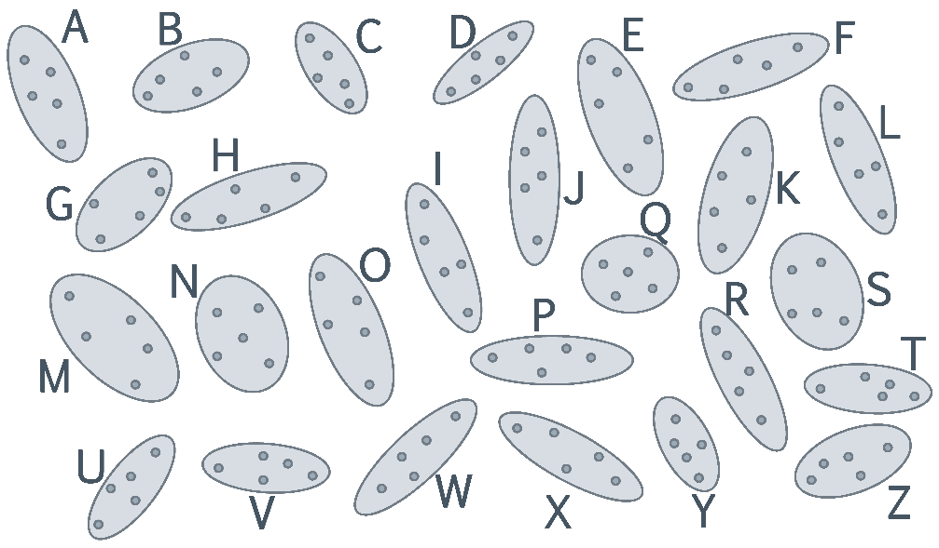
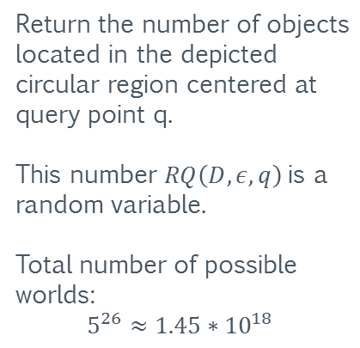
Querying Uncertain Data: Running Example
Return the number of objects located in the depicted circular region centered at query point q.
This number $RQ\left(D,ε,q\right)$is a random variable.
Total number of possible worlds:
$$5^{26}≈1.45∗{10}^{18}$$
q

Slide 30

Data Cleaning: Aggregation
Ignore Uncertainty (Data Cleaning)
Replace uncertain objects by a deterministic
“best guess”
    Expected Positions
    Most-likely Positions
    …
Query results are not reliable!
Query results may be biased!
D
C
q
H
I

Slide 31
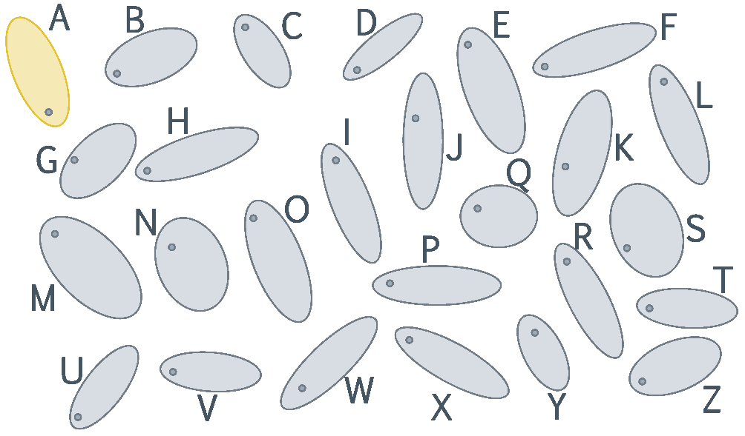

Equivalent Worlds: An intuition
Observation #1:
For any possible world $w$and any possible world $w^{′}$derived from $w$by changing the position of object $A,$the following equivalence holds
$$RQ\left(w_{1},ε,q \right)=RQ\left(w_{2},ε,q \right)$$
q

Slide 32
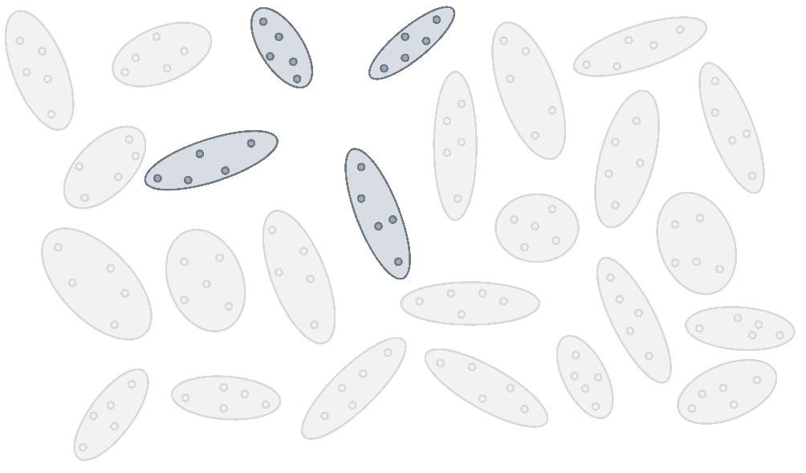
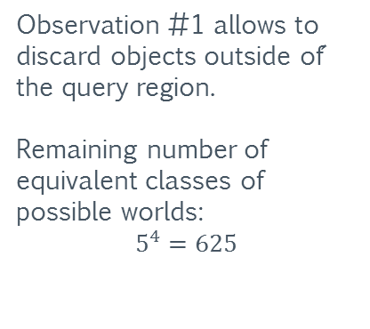
Equivalent Worlds: An intuition
Observation #1 allows to discard objects outside of´ the query region.
Remaining number of equivalent classes of possible worlds:
$$5^{4}=625$$
q

Slide 33

Equivalent Worlds: An intuition
Querying Uncertain Spatial Data
C
D
Observation #2:
For each remaining object, we only need to consider the predicate “inside”.
q
H
I

Slide 34
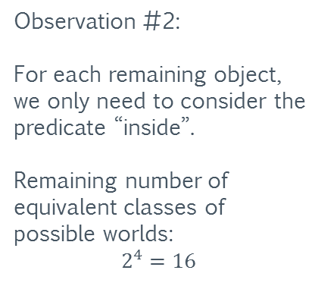
Equivalent Worlds: An intuition
C
D
Observation #2:
For each remaining object, we only need to consider the predicate “inside”.
Remaining number of equivalent classes of possible worlds:
$$2^{4}=16$$
q
H
I

Slide 35
Equivalent Worlds: An intuition
C
D
Observation #3:
We only require the number of objects in the query region.
Information about concrete results objects can be discarded.
q
H
I

Slide 36
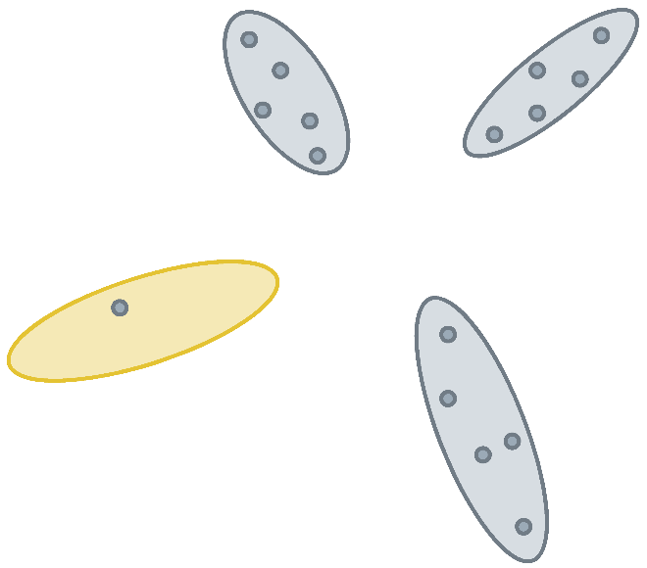

Generating Functions
Main idea: Use polyomial multiplication to enumerate
possible results
$\left(0.2A+0.8\overline{A}\right)⋅\left(0.4B+0.6\overline{B}\right)⋅\left(0.8C+0.2\overline{C}\right)=$
$0.064ABC+0.016AB\overline{C}+0.096A\overline{B}C+0.024A\overline{B}\overline{C}+$
$0.256\overline{A}BC+0.064\overline{A}B\overline{C}+0.384\overline{A}\overline{B}C+0.096\overline{A}\overline{B}\overline{C}$
C
A
0.8
0.2
q
H
H₃
0.4
B

Slide 37
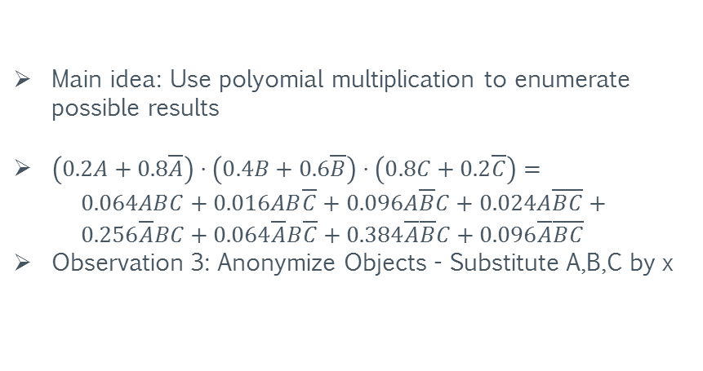
Generating Functions
Main idea: Use polyomial multiplication to enumerate
possible results
$\left(0.2A+0.8\overline{A}\right)⋅\left(0.4B+0.6\overline{B}\right)⋅\left(0.8C+0.2\overline{C}\right)=$
$0.064ABC+0.016AB\overline{C}+0.096A\overline{B}C+0.024A\overline{B}\overline{C}+$
$0.256\overline{A}BC+0.064\overline{A}B\overline{C}+0.384\overline{A}\overline{B}C+0.096\overline{A}\overline{B}\overline{C}$
Observation 3: Anonymize Objects - Substitute A,B,C by x
x
x
0.8
0.2
q
H
H₃
0.4
x

Slide 38
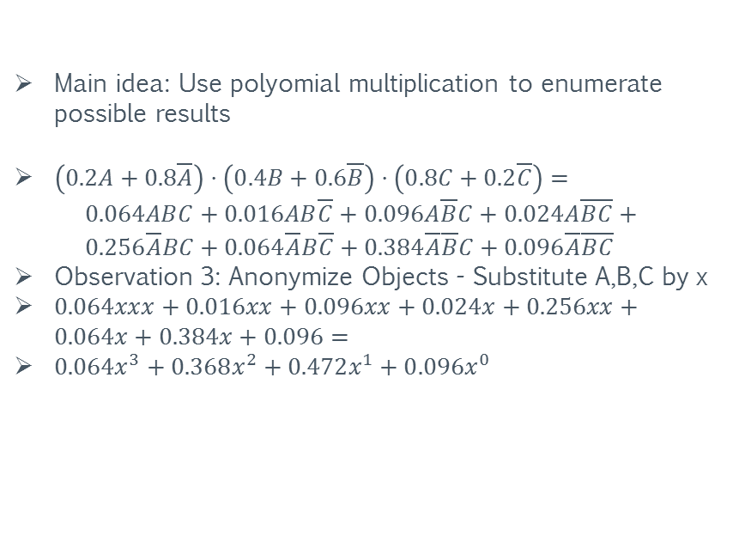
Generating Functions
Main idea: Use polyomial multiplication to enumerate
possible results
$\left(0.2A+0.8\overline{A}\right)⋅\left(0.4B+0.6\overline{B}\right)⋅\left(0.8C+0.2\overline{C}\right)=$
$0.064ABC+0.016AB\overline{C}+0.096A\overline{B}C+0.024A\overline{B}\overline{C}+$
$0.256\overline{A}BC+0.064\overline{A}B\overline{C}+0.384\overline{A}\overline{B}C+0.096\overline{A}\overline{B}\overline{C}$
Observation 3: Anonymize Objects - Substitute A,B,C by x
$0.064xxx+0.016xx+0.096xx+0.024x+0.256xx+0.064x+0.384x+0.096=$
$0.064x^{3}+0.368x^{2}+0.472x^{1}+0.096x^{0}$
x
x
0.8
0.2
q
H
H₃
0.4
x

Slide 39
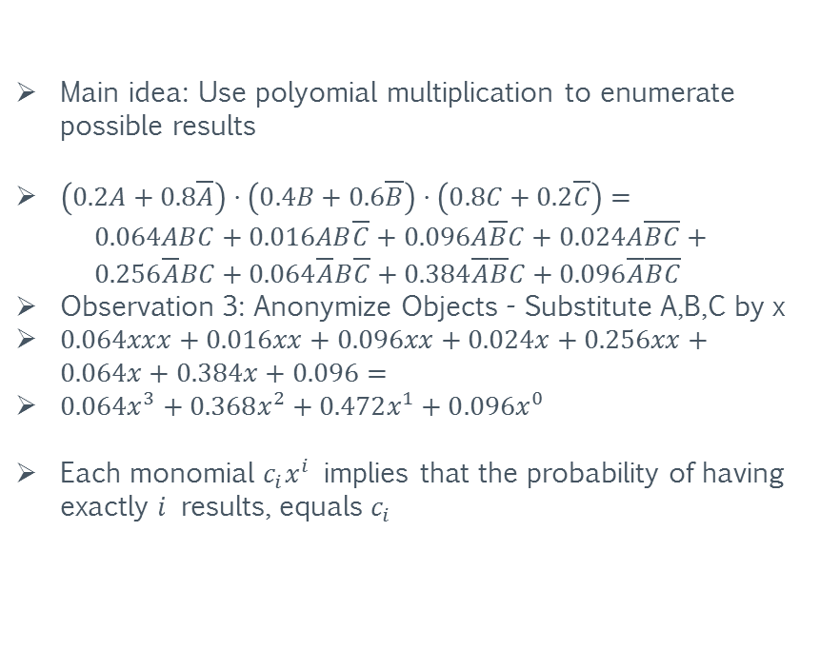
Generating Functions
Main idea: Use polyomial multiplication to enumerate
possible results
$\left(0.2A+0.8\overline{A}\right)⋅\left(0.4B+0.6\overline{B}\right)⋅\left(0.8C+0.2\overline{C}\right)=$
$0.064ABC+0.016AB\overline{C}+0.096A\overline{B}C+0.024A\overline{B}\overline{C}+$
$0.256\overline{A}BC+0.064\overline{A}B\overline{C}+0.384\overline{A}\overline{B}C+0.096\overline{A}\overline{B}\overline{C}$
Observation 3: Anonymize Objects - Substitute A,B,C by x
$0.064xxx+0.016xx+0.096xx+0.024x+0.256xx+0.064x+0.384x+0.096=$
$0.064x^{3}+0.368x^{2}+0.472x^{1}+0.096x^{0}$
Each monomial $c_{i}x^{i}$ implies that the probability of having exactly $i$ results, equals $c_{i}$
x
x
0.8
0.2
q
H
H₃
0.4
x

Slide 40
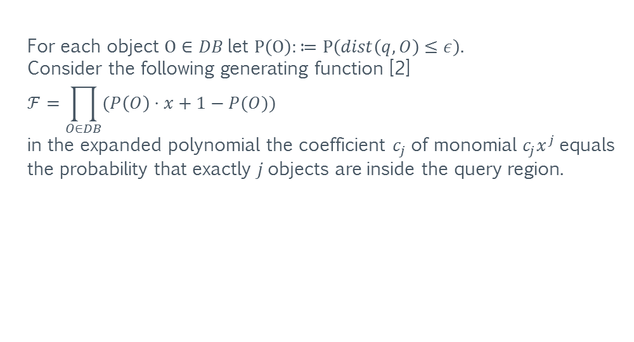
Generating Functions: Formally
For each object $O∈DB$let $P\left(O\right):≔P\left(dist\left(q,O\right)≤ε\right).$
Consider the following generating function [2]
$$ℱ=\prod_{O∈DB}{(P\left(O\right)⋅x+1−P(O))}$$
in the expanded polynomial the coefficient $c_{j}$of monomial $c_{j}x^{j}$equals the probability that exactly $j$objects are inside the query region.
[2] Jian Li, Barna Saha and Amol Deshpande: A Unified Approach to Ranking in Probabilistic Databases. PVLDB 2(1): 502-513 (2009).

Slide 41
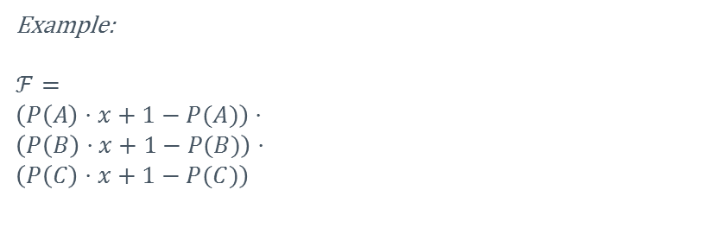
Count Queries on Uncertain Data
Example:
$$ℱ=$$
$$\left(P\left(A\right)⋅x+1−P(A)\right)⋅ \\ \left(P\left(B\right)⋅x+1−P(B)\right)⋅ \\ \left(P\left(C\right)⋅x+1−P(C)\right)$$
C
A
0.8
0.2
q
H
H₃
0.4
B

Slide 42

Count Queries on Uncertain Data
Example:
$$ℱ=$$
$$\left(P\left(A\right)⋅x+1−P(A)\right)⋅ \\ \left(P\left(B\right)⋅x+1−P(B)\right)⋅$$
$\left(P\left(C\right)⋅x+1−P(C)\right)$ =
$$\text{(0.2}\text{x}\text{+0.8)}⋅\text{(0.4}\text{x}\text{+0.6)}⋅\left(0.8x+0.2\right)=$$
$$\left(0.08x^{2}+0.12x+0.32x+0.48\right)⋅(0.8x+0.2)$$
C
A
0.8
0.2
q
H
H₃
0.4
B

Slide 43

Count Queries on Uncertain Data
Example:
$$ℱ=$$
$$\left(P\left(A\right)⋅x+1−P(A)\right)⋅ \\ \left(P\left(B\right)⋅x+1−P(B)\right)⋅$$
$\left(P\left(C\right)⋅x+1−P(C)\right)$ =
$$\text{(0.2}\text{x}\text{+0.8)}⋅\text{(0.4}\text{x}\text{+0.6)}⋅\left(0.8x+0.2\right)=$$
$\left(0.08x^{2}+0.12x+0.32x+0.48\right)⋅(0.8x+0.2)$ =
$$\left(0.08x^{2}+0.44x+0.48\right)⋅\left(0.8x+0.2\right)$$
C
A
0.8
0.2
q
H
H₃
0.4
B

Slide 44

Count Queries on Uncertain Data
Example:
$$ℱ=$$
$$\left(P\left(A\right)⋅x+1−P(A)\right)⋅ \\ \left(P\left(B\right)⋅x+1−P(B)\right)⋅$$
$\left(P\left(C\right)⋅x+1−P(C)\right)$ =
$$\text{(0.2}\text{x}\text{+0.8)}⋅\text{(0.4}\text{x}\text{+0.6)}⋅\left(0.8x+0.2\right)=$$
$\left(0.08x^{2}+0.12x+0.32x+0.48\right)⋅(0.8x+0.2)$ =
$$\left(0.08x^{2}+0.44x+0.48\right)⋅\left(0.8x+0.2\right)=$$
$$0.064x^{3}+0.368x^{2}+0.472x^{1}+0.096x^{0}$$
C
A
0.8
0.2
q
H
H₃
0.4
B

Slide 45
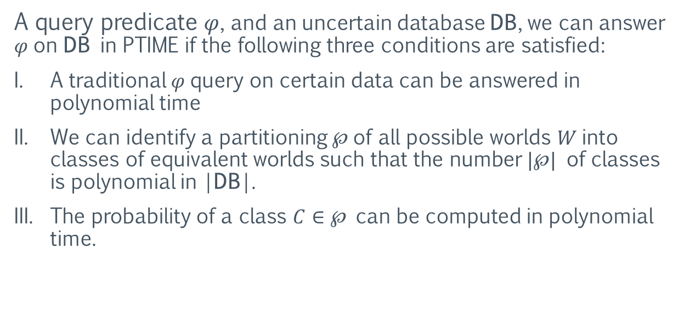
The Paradigm of Equivalent Worlds
A query predicate $φ$, and an uncertain database DB, we can answer $φ$on DB in PTIME if the following three conditions are satisfied:
A traditional $φ$query on certain data can be answered in polynomial time
We can identify a partitioning $℘$of all possible worlds $W$into classes of equivalent worlds such that the number $|℘|$ of classes is polynomial in |DB|.
The probability of a class $C∈℘$ can be computed in polynomial time.

Slide 46
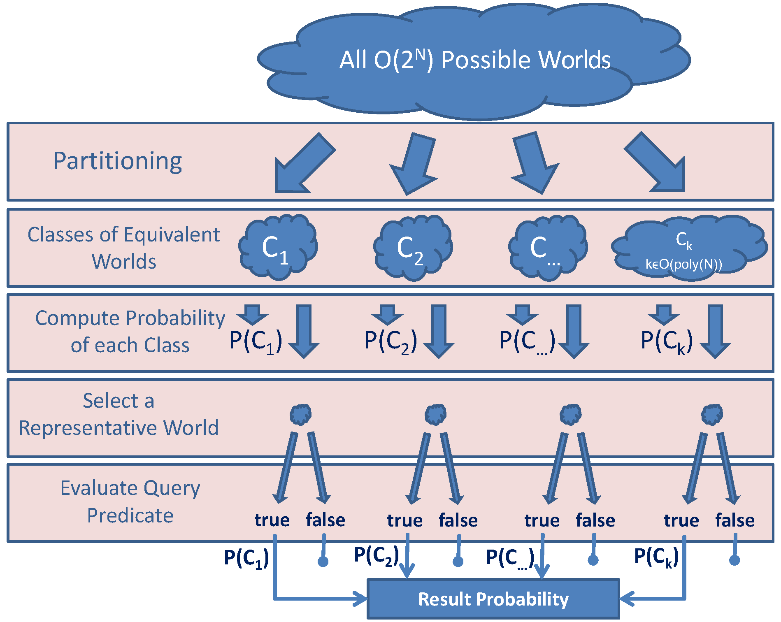
The Paradigm of Equivalent Worlds

Slide 47
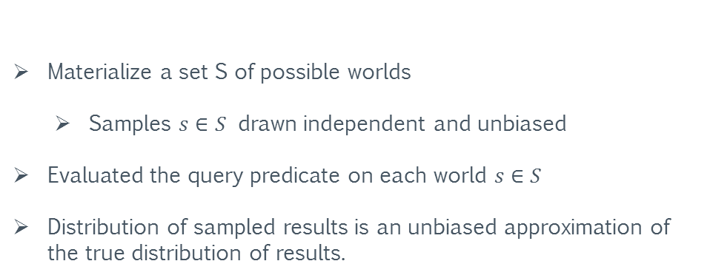
Approximated Results: Sampling
Materialize a set S of possible worlds
  Samples $s∈S$ drawn independent and unbiased
Evaluated the query predicate on each world $s∈S$
Distribution of sampled results is an unbiased approximation of the true distribution of results.

Slide 48

Sampling: Example
Drawing 100 possible worlds may yield the following
estimators:
$\hat{P}(RQ\left(D,ε,q\right)=0)=0.11;$
$\hat{P}(RQ\left(D,ε,q\right)=1)=0.54;$
$\hat{P}(RQ\left(D,ε,q\right)=2)=0.32;$
$\hat{P}\left(RQ\left(D,ε,q\right)=3\right)=0.03;$
Compare to the exact probabilities:
$P(RQ\left(D,ε,q\right)=0)=0.096;$
$P(RQ\left(D,ε,q\right)=1)=0.472;$
$P(RQ\left(D,ε,q\right)=2)=0.368;$
$P\left(RQ\left(D,ε,q\right)=3\right)=0.064;$
No indication of reliability or confidence of estimations!
C
A
0.8
0.2
q
H
H₃
0.4
B

Slide 49
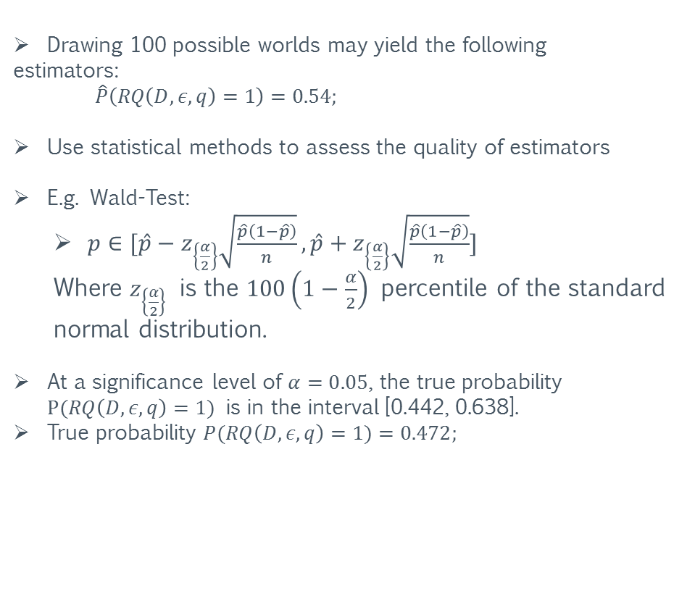
Sampling: Confidences
C
A
Drawing 100 possible worlds may yield the following
estimators:
$\hat{P}\left(RQ\left(D,ε,q\right)=1\right)=0.54;$
Use statistical methods to assess the quality of estimators
E.g. Wald-Test:
  $p∈[{\hat{p}−z}_{\left\{\frac{α}{2}\right\}}\sqrt{\frac{\hat{p}\left(1−\hat{p}\right)}{n}},{\hat{p}+z}_{\left\{\frac{α}{2}\right\}}\sqrt{\frac{\hat{p}\left(1−\hat{p}\right)}{n}}]$
  Where $z_{\left\{\frac{α}{2}\right\}}$ is the $100\left(1−\frac{α}{2}\right)$ percentile of the standard normal distribution.
At a significance level of $α=0.05$, the true probability $P(RQ\left(D,ε,q\right)=1)$ is in the interval [0.442, 0.638].
True probability $P(RQ\left(D,ε,q\right)=1)=0.472;$
0.8
0.2
q
H
H₃
0.4
B

Slide 50
Uncertain Spatial Data Management: Summary
Motivation
  Flood of geo-spatial data
  Enriched with additional contexts (text, social, multimedia)
  Inherent uncertainty
Data Cleaning
  “Best guess” answers.
  Unreliable results
  Biased results
Paradigm of Equivalent Worlds
  Efficient solution for the most prominent types of spatial queries
  Example: Generating Functions
Approximations
  Monte-Carlo sampling
  Probabilistic guarantees

Slide 51
Outline
Introduction
Uncertain Spatial Data
Uncertain Spatio-Temporal Data
(Geometric Approach)
Uncertain Spatio-Temporal Data
(Probabilistic Approach)

Slide 52
Models
  Motion
  Location Uncertainty
Queries
  Part 1: NN (free-space motion)
    Semantics and Processing
  Part 2: Range (road-networks constraints)
    Semantics and Processing
Uncertainty – the flip-side

Slide 53

Model of a trajectory
Time
3d-TRAJECTORY
Present time
Point Objects:
NOTE: the model needs to be augmented for objects with extent, e.g., hurricanes
X
2d-ROUTE
Y
Approximation: does not capture acceleration/deceleration
Bart Kuijpers, Harvey J. Miller, Walied Othman: Kinetic space-time prisms. GIS 2011

Slide 54
Mobility Models
sequence of
(location,time)
updates
(e.g., GPS-based)
Electronic maps + traffic distribution
patterns + set of (to be visited) point
=> full trajectory
(location,time, Velocity Vector )
updates
now ->
Notes:
Note that in the 2nd model, we may end up having to do bulk-updates and bulk-queries-re-evaluation if some disturbancy (e.g., a road-work or an accident) changes the parameters (e.g., max-speed/flow) used in calculating the future/full trajectories along the affected road-segments…

Slide 55
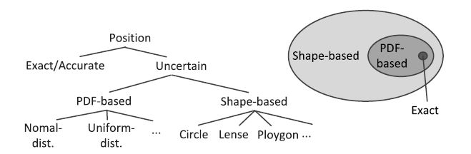
Modeling Uncertainty
Location Uncertainty Models
Various Sources’ Imprecision
(GPS; Sensors)
Quest for data reduction
Ralph Lange, Harald Weinschrott, Lars Geiger, André Blessing, Frank Dürr, Kurt Rothermel, Hinrich Schütze: On a
Generic Uncertainty Model for Position Information. QuaCon 2009.

Slide 56
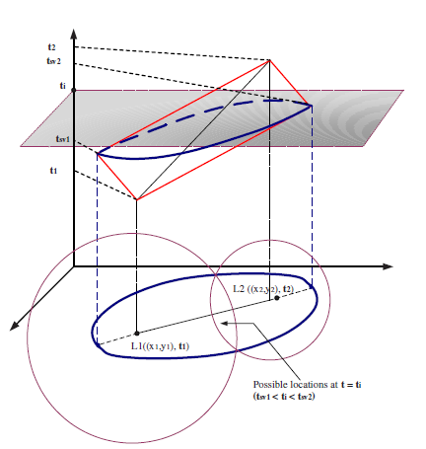
Modeling Uncertain Trajectories
Model 1:
Cones, Beads, Necklaces (AKA space-time prisms)
  Assumed exact location samples
  Unknown (but bounded)
  maximum speed in-between
  samples
Reynold Cheng, Sunil Prabhakar, Dmitri V. Kalashnikov: Querying Imprecise Data in Moving Object Environments. ICDE 2003.
G. Trajcevski, A. Choudhary, O. Wolfson, G. Li, Uncertan Range Queries for Necklases. MDM 2010.

Slide 57
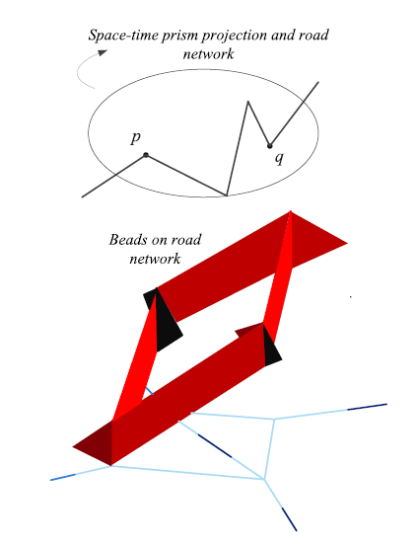
Modeling Uncertain Trajectories
Model 2:
Constraints
Motion along road network
t2
t1
t
Uncertainty restricted to
Road Segments
q
p1 p2
Bart Kuijpers, Walied Othman: Modeling uncertainty of moving objects on road networks via space-time prisms. International Journal of Geographical Information Science 23(9): (2009)

Slide 58
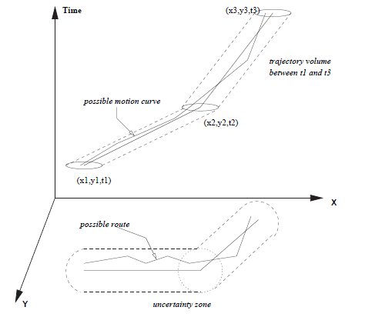
Modeling Uncertain Trajectories
Model 3:
Sheared Cylinders
Constant bound on
location-error at any
time-instant
G. Trajcevski, O. Wolfson, K. Hinrichs, S. Chamberlain. Managing Moving Objects Databases with Ucertainty, ACM TODS, 2004.

Slide 59
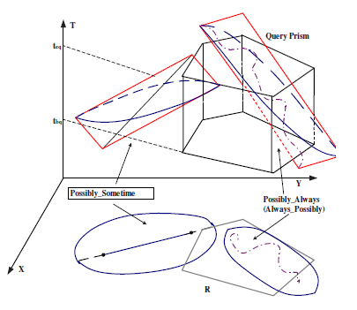
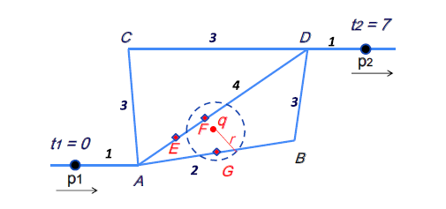
Processing Spatio-Temporal Queries for Uncertain Trajectories
Need to jointly consider:
Syntax:
The impact of uncertainty on the
(structure of the) answer
The impact of constraints
Processing Algorithms:
Impact of the motion+uncertainty
coupling on filtering/prunning/refinement
e.g., possible routes to be taken
Notes:
But a couple of general observations, before we focus on the two categories of queries presented in detail

Slide 60
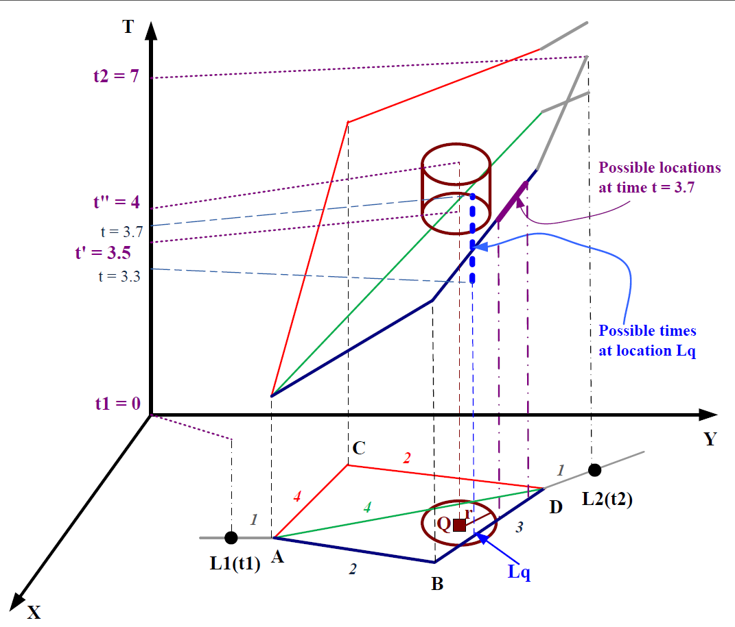
Example: inside range (disk) around “Q” between t1 and t2
What is the probability of a path taken?
2. What is the earliest/latest
arrival at a given vertex (consequently, along edge)
Kai Zheng, Goce Trajcevski, Xiaofang Zhou, Peter Scheuermann: Probabilistic range queries for uncertain trajectories on road networks. EDBT 2011.
60

Slide 61
Continuous NN for trajectories
Given a collection of moving objects trajectories {Tr1, Tr2, …, TrN}
Q_nn(q): Retrieve the nearest neighbor of the moving object whose trajectory is Trq, between [tb,te].
A-nn(q): [(Tri1, [tb,t1]); (Tri2,[t1,t2]); …; (Trim,[tm-1,te])]
Observation:
The answer to the query is time-paremeterized
Example, assuming that Trq is the querying trajectory, between [tb,te], then:
- Tr1 (black) is the NN throughout [tb,t1];
- Tr2 (red) is the NN throughout [t1,te]
Yufei Tao, Dimitris Papadias, Qiongmao Shen: Continuous Nearest Neighbor Search. VLDB 2002.
Notes:
When asking an NN-query for a collection of moving objects trajectories, even if the querying object is static, and especially so if the querying object itself is moving, the key observation is that the structure of the answer is such that different (trajectories of) moving objects may be the actual NN during different time-intervals. Example follows. Consider the scenario illustrated in the Figure, where we have a collection of 4 trajectories…

Slide 62
Impact of Uncertainty
Given{Tr1, Tr2, …, TrN}, where each Tri has some location uncertainty associated with its location at each time-instant, consider the variant:
UQ_nn(q): Retrieve the all the objects whose trajectories have a non-zero probability of being a nearest neighbor of the moving object whose trajectory is Trq, between [tb,te].
Observations
adding uncertainty to the previous example, implies:
Tr1 (blue) is the exclusive non-zero NN-probability,
up to tb1;
Starting at tb1, Tr3 (green) also has a
non-zero NN-probability;
Specifically, at t11, all three trajectories have a
non-zero NN-probability
? = what should the structure of
the answer to UQ_nn(q) look like
Notes:
Now we proceed with considering the impact of the uncertainty on the continuous NN-queries. As an example, once again we assume “Given a collection…”
Looking at the Figure:
To figure out who is “within possible distance” – at every time-instant we “bubble” a circle, centered at the expected location of the querying trajectory (see, e.g., tb1 and t11 in the Figure).
We have the following “Observations”… (listed as items on the slide…)
The moral of the story, and the main question raised by the observations, becomes: “? = what should…”

Slide 63
Structure of the Answer to Probabilistic NN-query for Trajectories
We propose the
IPAC-NN (Interval-basedProbabilistic Answer to a Continuous NN query) tree:
Root: parameters of the query
-Querying trajectory Trq
- Time-interval of interest [tb,te]
Children:
-if parent excluded, the trajectories that have the highest probability of being NN to Trq, within a sub-interval of the interval bounded by the parent

Slide 64


Instantaneous (i.e., spatial) NN-query when the querying object is crisp (i.e., no uncertainty)
Trq = 2D point Q;
The rest are possible-locations, bounded by circles
Observation:
Any object with min-distance from Q being > Rmax, has a “0”
probability of being a NN to Q
-Example: R4 cannot have a non-zero probability of being Q’s NN.
The probability that the location of Tri is within distance Rd from Q, is given by:
The probability that a given object Trj is the NN of Q is given by:
i.e., Trj is the NN if it’s at distance ≤ Rd, AND all the rest are at distances > Rd,
and integrating over all possible Rd’s (NOTE: the upper-bound is Rmax…)
Notes:
We respectfully note here that there is a large body of existing works that have addressed certain aspect of the NN-queries processing in spatial and spatio-temporal settings. We briefly review the necessary background here, however, we did our best to credit the relevant works by citing them and positioning them in the paper…

Slide 65
When Trq (the instantaneous location) has an uncertainty associated with it, the previous
observations are not directly applicable… Example:
We can no longer “prune” Tr4 from consideration.
The main problem now becomes how to calculate the probability of an
object, say, Trj, being within_distance Rd from Trq
NOTE: in effect, a quadruple-integration, instead of the double-one (cf. previous slide)…
Notes:
Now we discuss what is the actual impact when the querying object has an uncertainty associated with its location. PLS note that we are still considering only the “static” (or instantaneous case).

Slide 66

Example:
assuming a uniform pdf of possible-locations, but two of the
points to be used when evaluating the actual probability of Tr1
being within_distance Rd from Trq
Main Observation:
Let Vi and Vq denote the 2D random variables representing the possible locations of Tri and Trq
In effect, we are looking for
Define:
Viq = Vi – Vq (cross-correlation) as another random variable;
Viq = Vi + (-Vq)
which, due to the independence, implies that
the pdf ov Viq, is a convolution of the pdfs of Vi and –Vq !!!
Notes:
The Figure_Left shows two (of the uncountably-many) points, illustrating the evaluation of the probability of Tr1 being within_distance Rd from Trq.

Slide 67
Let Viq = Vi + (-Vq)
Property 1:
If pdf(Vi) has a centroid Ci coinciding with E(Vi)
AND pdf(Vq) has a centroid Cq coinciding with E(Vq)
THEN, their convolution pdf(Viq) has
a centroid Ciq = Ci + (-Cq), coinciding with E(Viq)
Property 2:
Assume that pdf(Vi) and pdf(Vq) have rotational symmetry around their centroids, and with respect to the vertical axis (the value of the pdf’s)
THEN pdf(Viq) is also rotationally-symmetric around its centroid Ciq
Notes:
Figure_left illustrates the main benefits of the convolution…
In the Property 1, E(Vi) denotes the Expected Value of the variable Vi (NOTE, reminder that each of the V’s is a 2D random variable)…

Slide 68
The continuous aspect of the probabilistic NN queries
Let Vxiq = vxi – vxq and Vyiq = vyi – vyq denote the corresponding components of
the velocity of the object whose expected location is along TRiq
Then, the distance of the expected location along TRiq from the origin, at a function of t is:
hyperbola, since A > 0
Now, we have a collection of such distance functions (for each i)
Notes:
Now we focus on the construction of the geometric-dual of the IPAC-NN tree, representing the answer of the probabilistic NN query. We rely on the observation that the difference of the two trajectories at any time-instance is a single random variable (their convolution) and the properties/lemma/theorem stated. Recall that Trq is the querying trajectory.

Slide 69
The continuous aspect of the probabilistic NN queries
Consequence: The problem of constructing the IPAC-NN tree can be reduced to the problem
of finding the collection of ranked lower envelopes, for a set of distance-functions
Sdf = {d1q(t), d2q(t),…,dNq(t)} (NOTE: excluding dqq(t)≡ 0)
Observation: Two distance functions diq(t) and djq(t), throughout the time-interval of interest for the query [tb,te], can intersect at most twice (NOTE: set diq(t) = djq(t))
Call such pair-wise intersections critical time-points.
Example:
Lower envelope of two distance-trajectories
NOTE: time-dimension on horizontal axis
critical time-point

Slide 70
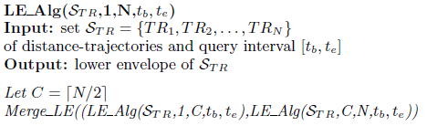
The continuous aspect of the probabilistic NN queries
Q: how to efficiently construct the lower envelope of the whole collection of distance-functions?
A: divide-and-conquer approach, in the spirit of Merge-Sort
Complexity of the lower envelope construction:
O(N logN) (N = number of trajectories)
Now, how about the IPAC-NN tree???
Notes:
NOTE: the details are explained in the paper. However, the idea is to recursively split the collection of the distance-functions/trajectories until each sub-collection consists of at most two of them.
Then, we find the critical time-points for each pair;
Then we proceed with merging the simpler results back, while in each merge-phase sweeping along the time-axis and adjusting accordingly the critical time-values of the merged sub-collections

Slide 71
The lower envelope provides a continuous-pruning criteria, i.e., any trajectory whose
distance function is further than 4r (r = radius of the uncertainty disk) can *not* have a non-zero probability of being NN to Trq (e.g., Tr7 in the Figure, and Tr6 initially)
Observation 3: IF the lower envelope is removed from the (distance-functions, time) space,
THEN the lower envelope of the leftovers corresponds to the “grandchildren” of the root of
the IPAC-NN tree
Notes:
Now we focus on the construction of the IPAC-NN tree via its geometric dual… The detailed algorithm is available in the paper, however, the intuition is as summarized with the respective observations (cf. the Figure)

Slide 72
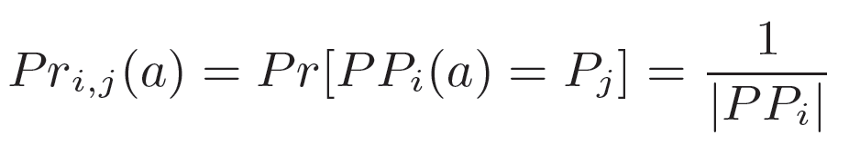

Given two trajectory samples (ti; pi) and (t_{i+1}; p_{i+1}) of a moving object a on road network, the set of possible paths (PPi) between ti and t_{i+1} consists of all the paths along the routes
(sequence of edges) that connect pi and pi+1, and whose minimum time costs are not greater than t_{i+1} - ti, i.e.,
Example: if pdf of selecting a possible path is uniform :
Given a path Pj ∈PPi(a), the Possible Locations of a given moving object a with respect to Pj at t ∈ [ti; ti+1] is the set of all the positions p ∈Pj from which a can reach pi (respectively, pi+1) within time period t - ti (respectively, ti+1 - t)
i.e.,

Slide 73
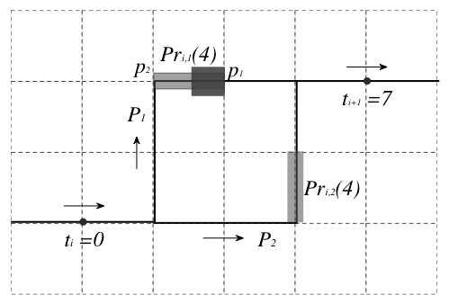

Combine the two probabilities…
Probability of an object a falling inside some segment S at given time instant t :
Probability of falling inside segment mp₁
0.5*0.5 = 0.25 (at t = 4)
m
Possible locations when t=4
Possible paths
a
e.g., uniform pdf

Slide 74
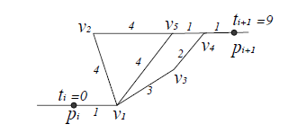
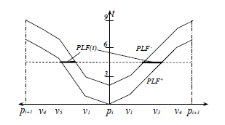
Construction/Representation
Given location-in-time samples, to obtain an uncertain trajectory representation, we need:
  The collection of all the possible paths (and probabilities)
  Probabilistic Location Function
  Example: observe the two possible
  sequences of going from position pi
  to position p_{i+1}
  At the time-instant t = 4, the object can
  be in certain segments either along the edge v₁v₅ or along the edge(s) v₁v₃ (+ v₃v₄ )
Notes:
Note that, although there are *3* possible routes on the top-left figure, there are actually *2* possible trajectories that the object could have taken between p_i and p_(i+1). The reason is that the top-most one (i.e., p_i->v1->v2->v5->v4->p_(i+1)) has a duration of 10 units under the max-speeds along the segments, which violates that actual data (time-stamps of t=0 at p_i, and t = 9 at p_(i+1)).

Slide 75
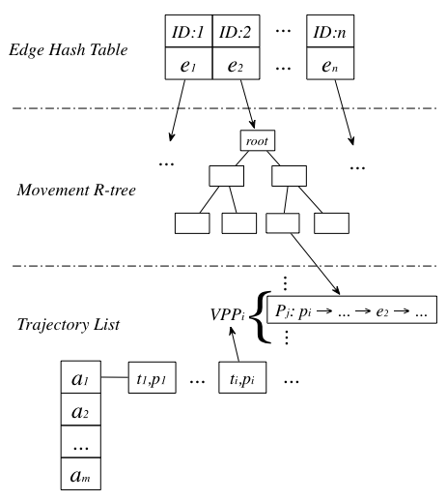
Processing
Data Structures:
  Edge hash-table
    Small, in-memory
  Movement R-tree
    1D, for each edge
  Trajectories List
    Store samples ordered by time-stamp
    Assign pointer to set of possible paths
    Earliest-arriving and Latest-departure stored for vertices
    On-disk, retrieve on-demand

Slide 76
Network expansion
  Expansion tree: a tree rooted in q and contains the edges whose network distances with q are smaller than r
Filtering
  Fetch the movement R-trees of the edges in expansion tree
  Search leaf entries whose maximum time interval intersect with t_{q}
  The objects pointed by those leaf entries are candidates
Refinement
  The candidate set is considerably smaller than original trajectory dataset
  Calculate the qualification probability for each candidate
earliest/latest times of arrival
possible path, but definitely not part of the
answer to the range query
D
E
A
C
B
q
expansion tree “bubbling”
along road-network segments

Slide 77

Temporal-continuous query
  Only calculate the QPs for a few critical time instants: the earliest arriving time and latest departure time at each vertex along the possible path
  Easy to prove that the actual QP is monotonic in-between consecutive critical time instants
  The QPs critical time instants define an envelop function for the actual QPs

Slide 78


Uncertainty – the flip-side
Data reduction:
  Why transmitting every single location point?
    Bandwidth
    Energy
Adapt spatial/map approaches
  ⇒ Define acceptable error; Save on data-size
John Hershberger, Jack Snoeyink “Speeding up Douglas-Peucker Line-simplification Algorithm”, SSHD 1997.

Slide 79
Uncertainty – the other-flip-side
What are the important properties not to be distorted with reduction?
  Topological properties (e.g., two non-intersecting regions should not intersect after reduction)
What is the impact/role of time in the picture?
  Is it not “Z” axis… cannot travel back in time.
  How long should the sink data to be “un-fresh”

Slide 80
Outline
Introduction
Uncertain Spatial Data
Uncertain Spatio-Temporal Data
(Geometric Approach)
Uncertain Spatio-Temporal Data
(Probabilistic Approach)

Slide 81


So far …
Stochastic methods for uncertain spatial data
Probabilisitc results
Time dimension
Geometric models for uncertain spatio-temporal data
Probabilisitc results
Time dimension
vs.

Slide 82
Merge the approaches
Idea
  Discretize the time
  For each time a pdf (pmf) over the possible position is given
Examples
  Nearest Neighbour Queries on uncertain moving objects
  Similarity Search on uncertain time series
Problem: Independency assumption prohibits time-parametrized queries
  R. Cheng, D. Kalashnikov, and S. Prabhakar, “Querying imprecise data in moving object environments,” in IEEE TKDE, vol. 16, no. 9, 2004, pp. 1112–1127.
  Johannes Aßfalg, Hans-Peter Kriegel, Peer Kröger, Matthias Renz: „Probabilistic Similarity Search for Uncertain Time Series“ SSDBM 2009: 435-443

Slide 83

A highway example…
t
Q
What is the probability that the car is in some area at least once during some time?
pos

Slide 84
A highway example…
v_{min}
v_{max}
t
Q
What is the probability that the car is in some area at least once during some time?
pos
Notes:
No second observation for now

Slide 85
A highway example…
v_{min}
v_{max}
t
Q
Assuming uniform distribution…
pos

Slide 86
A highway example…
t
Q
30%
50%
    Independence assumption:
    1 – (1-0.5)*(1-0.3) = 0.65
pos

Slide 87
A highway example…
Violation of the
speed constraints!
t
Q
30%
50%
    Independence assumption:
    1 – (1-0.5)*(1-0.3) = 0.65
pos

Slide 88
A highway example…
t
Q
30%
50%
    Independence assumption:
    1 – (1-0.5)*(1-0.3) = 0.65
    Consideration of dependency:
    = 0.5
pos
Notes:
We have to capture not only the uncertainty at each point of time but also how it evolves between these times

Slide 89
An adequate model

Slide 90
Stochastic Processes
Stochastic Processes are used to represent the evolution of some random value, or system, over time.
A sound mathematical model which can be used to describe the uncertain location of an object over time.
Many Stochastic Processes for different settings:
  Discrete Time + Discrete Space (e.g. Markov Chain)
  Discrete Time + Continuous Space (e.g. Harris Chain)
  Continuous Time + Discrete Space (e.g. Markov Process)
  Continuous Time + Continuous Space (e.g. Wiener Process)
Doob, J. L. (1953). Stochastic Processes. Wiley.

Slide 91


A simple example
Whenever the wooden board is hit, the ball stays or drops into one of the neighbour holes with certain probabilities.
At the border of the wood board these probabilities are different
This model is usually learned or given by experts
0.4
0.2
0.4
0.6
0.4

Slide 92
A simple example
Initial Position
After first hit
After second hit
After 40th hit
0.4
0.2
0.4
0.16
0.16
0.36
0.16
0.16
0.08
0.12
0.12
0.12
0.12
0.12
0.12
0.12
0.08

Slide 93
How can we model this?
A Markov Chain is a “memoryless” Stochastic Process (the next state depends only on the current state)
For our example we build the following transition Matrix M
to bucket
0.4 | 0.6 | 0 | 0 | 0 | 0 | 0 | 0 | 0
0.4 | 0.2 | 0.4 | 0 | 0 | 0 | 0 | 0 | 0
0 | 0.4 | 0.2 | 0.4 | 0 | 0 | 0 | 0 | 0
0 | 0 | 0.4 | 0.2 | 0.4 | 0 | 0 | 0 | 0
0 | 0 | 0 | 0.4 | 0.2 | 0.4 | 0 | 0 | 0
0 | 0 | 0 | 0 | 0.4 | 0.2 | 0.4 | 0 | 0
0 | 0 | 0 | 0 | 0 | 0.4 | 0.2 | 0.4 | 0
0 | 0 | 0 | 0 | 0 | 0 | 0.4 | 0.2 | 0.4
0 | 0 | 0 | 0 | 0 | 0 | 0 | 0.6 | 0.4
from bucket
= M

Slide 94
How can we model this?
First hit
Second hit
40th hit
0.4 | 0.6 | 0 | 0 | 0 | 0 | 0 | 0 | 0
0.4 | 0.2 | 0.4 | 0 | 0 | 0 | 0 | 0 | 0
0 | 0.4 | 0.2 | 0.4 | 0 | 0 | 0 | 0 | 0
0 | 0 | 0.4 | 0.2 | 0.4 | 0 | 0 | 0 | 0
0 | 0 | 0 | 0.4 | 0.2 | 0.4 | 0 | 0 | 0
0 | 0 | 0 | 0 | 0.4 | 0.2 | 0.4 | 0 | 0
0 | 0 | 0 | 0 | 0 | 0.4 | 0.2 | 0.4 | 0
0 | 0 | 0 | 0 | 0 | 0 | 0.4 | 0.2 | 0.4
0 | 0 | 0 | 0 | 0 | 0 | 0 | 0.6 | 0.4
= (
0 | 0.2 | 0.4 | 0.2 | 0 | 0 | 0 | 0 | 0
)
(
0 | 0 | 1 | 0 | 0 | 0 | 0 | 0 | 0
) *
(
0 | 0.4 | 0.2 | 0.4 | 0 | 0 | 0 | 0 | 0
) * M = (
0.16 | 0.16 | 0.36 | 0.16 | 0.16 | 0 | 0 | 0 | 0
)
(
0 | 0 | 1 | 0 | 0 | 0 | 0 | 0 | 0
) * M⁴⁰ = (
0.8 | 0.12 | 0.12 | 0.12 | 0.12 | 0.12 | 0.12 | 0.12 | 0.08
)

Slide 95

Fusion of Model and Reality
Discretization of time and space
  E.g. treat intersections as
  states and add additional states
  on long streets
  The time interval corresponding
  to a tick is e.g. 20 sec
Estimation of model parameters
  Transition probabilities from one state to another are learned from historical data (very sparse matrix!!)
  Transition matrix can change over time and for different object groups

Slide 96
Querying the Model
T. Emrich, H.-P. Kriegel, N. Mamoulis, M. Renz, and A. Züfle. Querying uncertain spatio-temporal data. In Proceedings of the 28th International Conference on Data Engineering (ICDE), Washington, DC, 2012.

Slide 97

ST - Window Queries
Given the following state states and transition probabilities, what is the probability that the car is in s₁ or s₂ in the time interval T = [2,3]?
s₂
0.6
s₁
0.4
0.6
1.0
s₃
Note: We have an exponential number of
possible paths the car might take!
0.2
$$M=\left(\begin{matrix}0 & 0 & 1 \\ 0.6 & 0 & 0.4 \\ 0 & 0.8 & 0.2\end{matrix}\right)$$

Slide 98


ST - Window Queries
Given the following state states and transition probabilities, what is the probability that the car is in s₁ or s₂ in the time interval T = [2,3]?
s₂
0.6
s₁
s₁
0.4
0.6
s₂
1.0
s₃
s₃
0.2
t=0
t=1
t=2
t=3
$$\left(\begin{aligned}1 \\ 0 \\ 0\end{aligned}\right)$$
$$M=\left(\begin{matrix}0 & 0 & 1 \\ 0.6 & 0 & 0.4 \\ 0 & 0.8 & 0.2\end{matrix}\right)$$

Slide 99


ST - Window Queries
Given the following state states and transition probabilities, what is the probability that the car is in s₁ or s₂ in the time interval T = [2,3]?
s₂
0.6
s₁
s₁
0.4
0.6
s₂
1.0
s₃
s₃
0.2
t=0
t=1
t=2
t=3
$$\left(\begin{aligned}1 \\ 0 \\ 0\end{aligned}\right)$$
$$\left(\begin{aligned}0 \\ 0 \\ 1\end{aligned}\right)$$
$$M=\left(\begin{matrix}0 & 0 & 1 \\ 0.6 & 0 & 0.4 \\ 0 & 0.8 & 0.2\end{matrix}\right)$$
*$M$

Slide 100


ST - Window Queries
Given the following state states and transition probabilities, what is the probability that the car is in s₁ or s₂ in the time interval T = [2,3]?
s₂
0.6
s₁
s₁
0.4
0.6
s₂
1.0
s₃
s₃
0.2
t=0
t=1
t=2
t=3
$$\left(\begin{aligned}1 \\ 0 \\ 0\end{aligned}\right)$$
$$\left(\begin{aligned}0 \\ 0 \\ 1\end{aligned}\right)$$
$$\left(\begin{aligned}0 \\ 0.8 \\ 0.2\end{aligned}\right)$$
$$M=\left(\begin{matrix}0 & 0 & 1 \\ 0.6 & 0 & 0.4 \\ 0 & 0.8 & 0.2\end{matrix}\right)$$
*$M$
*$M$

Slide 101


ST - Window Queries
Given the following state states and transition probabilities, what is the probability that the car is in s₁ or s₂ in the time interval T = [2,3]?
s₂
0.6
s₁
s₁
0.4
0.6
s₂
1.0
s₃
s₃
0.2
t=0
t=1
t=2
t=3
$$\left(\begin{aligned}1 \\ 0 \\ 0\end{aligned}\right)$$
$$\left(\begin{aligned}0 \\ 0 \\ 1\end{aligned}\right)$$
$$\left(\begin{aligned}0 \\ 0.8 \\ 0.2\end{aligned}\right)$$
$$\left(\begin{aligned}0.48 \\ 0.16 \\ 0.36\end{aligned}\right)$$
$$M=\left(\begin{matrix}0 & 0 & 1 \\ 0.6 & 0 & 0.4 \\ 0 & 0.8 & 0.2\end{matrix}\right)$$
*$M$
*$M$
*$M$

Slide 102

ST - Window Queries
Given the following state states and transition probabilities, what is the probability that the car is in s₁ or s₂ in the time interval T = [2,3]?
s₂
0.6
s₁
s₁
0.4
0.6
s₂
1.0
s₃
s₃
0.2
t=0
t=1
t=2
t=3
$$\left(\begin{aligned}1 \\ 0 \\ 0\end{aligned}\right)$$
$$\left(\begin{aligned}0 \\ 0 \\ 1\end{aligned}\right)$$
$$\left(\begin{aligned}0 \\ 0.8 \\ 0.2\end{aligned}\right)$$
$$\left(\begin{aligned}0.0 \\ 0.16 \\ 0.04\end{aligned}\right)$$
$$M=\left(\begin{matrix}0 & 0 & 1 \\ 0.6 & 0 & 0.4 \\ 0 & 0.8 & 0.2\end{matrix}\right)$$
*$M$
*$M$
*$M$
Result = 0.96

Slide 103









ST - Window Queries
Solution based on matrix multiplications introduces a new state for the winner trajectories and two matrices
s₁
$$M^{−}=\left(\begin{matrix}0 & 0 & 1 & 0 \\ 0.6 & 0 & 0.4 & 0 \\ 0 & 0.8 & 0.2 & 0 \\ 0 & 0 & 0 & 1\end{matrix}\right)$$
s₂
s₃
s₄
$$M^{+}=\left(\begin{matrix}0 & 0 & 1 & 0 \\ 0 & 0 & 0.4 & 0.6 \\ 0 & 0 & 0.2 & 0.8 \\ 0 & 0 & 0 & 1\end{matrix}\right)$$
$$\left(\begin{aligned}1 \\ 0 \\ 0 \\ 0\end{aligned}\right)$$
$$\left(\begin{aligned}0 \\ 0 \\ 1 \\ 0\end{aligned}\right)$$
$$\left(\begin{aligned}0 \\ 0 \\ 0.2 \\ 0.8\end{aligned}\right)$$
$$\left(\begin{aligned}0 \\ 0 \\ 0.04 \\ 0.96\end{aligned}\right)$$
*$M−$
*$M+$
*$M+$

Slide 104
Multiple Observations
So far we had only one observation
from which we could extrapolate
This is not really of interest since
cars do not move randomly
With two observations we have to
introduce more artificial states and
adapt the techniques
location space
t₀
time space
location space
t₀
time space
t₁

Slide 105

Multiple Observations
We need to track where true hit worlds are located
  2*|S| classes of equivalent worlds
  One class S_{i}⁻ corresponding to worlds where o is located in state s_{i}, and o has not intersected the window
  One class S_{i}⁺ corresponding to worlds where o is located in state s_{i}, and o has not intersected the window
s₁
$$M=\left(\begin{matrix}0 & 0 & 1 \\ 0.6 & 0 & 0.4 \\ 0 & 0.8 & 0.2\end{matrix}\right)$$
s₂
s₃
t=0
t=1
t=2
t=3

Slide 106












Multiple Observations
s₁
$$M=\left(\begin{matrix}0 & 0 & 1 \\ 0.6 & 0 & 0.4 \\ 0 & 0.8 & 0.2\end{matrix}\right)$$
s₂
s₃
$$M^{−}=\left(\begin{aligned}M 0 \\ 0 M\end{aligned}\right)$$
t=0
t=1
t=2
t=3
S₁⁻
S₂⁻
S₃⁻
S₁⁺
S₂⁺
S₃⁺
$$\left(\begin{aligned}1 \\ 0 \\ 0 \\ 0 \\ 0 \\ 0\end{aligned}\right)$$
$$\left(\begin{aligned}0 \\ 0 \\ 1 \\ 0 \\ 0 \\ 0\end{aligned}\right)$$
$$\left(\begin{aligned}0 \\ 0 \\ 0.2 \\ 0 \\ 0.8 \\ 0\end{aligned}\right)$$
$$\left(\begin{aligned}0 \\ 0.16 \\ 0.04 \\ 0.48 \\ 0 \\ 0.32\end{aligned}\right)$$
$$M^{+}=\left(\begin{aligned}0.0 0.0 1.0 0.0 0.0 0.0 \\ 0.0 0.0 0.4 0.6 0.0 0.0 \\ 0.0 0.0 0.2 0.0 0.8 0.0 \\ 0.0 0.0 0.0 0.0 0.0 1.0 \\ 0.0 0.0 0.0 0.6 0.0 0.4 \\ 0.0 0.0 0.0 0.0 0.8 0.2 \end{aligned}\right)$$
$$¬∎$$
$$∎$$
*$M^{+}$
*$M^{+}$
*$M^{−}$

Slide 107





Bayes’ Theorem
Now what is the probability that the trajectory passes the query window given the fact that the object was seen in s₃?
$$\left(\begin{aligned}0 \\ 0.16 \\ 0.04 \\ 0.48 \\ 0 \\ 0.32\end{aligned}\right)$$
$$P\left(∎\right| )=\frac{P( |∎)∗P(∎)}{P( )}$$
$$=\frac{P(∎∧ )}{P( )}$$
S₁⁻
S₂⁻
S₃⁻
S₁⁺
S₂⁺
S₃⁺
$$=\frac{P(∎∧ )}{P\left( ∧∎\right)+P( ∧¬∎)}$$
$$=\frac{0.32}{0.32+0.04}=0.89$$

Slide 108
Summary
Pros
  Allows to answer time-parametrized queries according to possible worlds semantics
  Considers location dependencies over time
  Scales up very well since it is purely based on sparse matrix multiplications
  Natively extendable for uncertain observations
  Seems to work adequately on real-world data (more validation needed)
Cons
  Discrete time and space
  Matching from time to tics might not be the perfect modelling

Slide 109
Selected Works

Slide 110
Indexing UST Data
With the above techniques each object in the database has to be processed
Index Structure based on R-Tree indexing the ST-Space
The leafs contain the “intelligence” and enable probabilistic pruning (at max x% of the possible trajectories of o may intersect Q)
location
P
oid
λ
time
T. Emrich, H.-P. Kriegel, N. Mamoulis, M. Renz, and A. Züfle. Indexing uncertain spatio-temporal data. In Proceedings of the 21th ACM CIKM, Maui, Hawaii, USA, 2012.

Slide 111

KNN queries + Sampling on UST Data
Not all queries can be solved as elegant as window queries
Popular in uncertain databases: Monte-Carlo-Sampling
  Draw a sufficiently high number of
  samples
  Approximate result probability = ratio
  of samples that satisfy the query and
  total number of drawn samples
But how to draw samples efficiently
such that they are conform with the
observations?
Solution: Adaption of transition matrices
Johannes Niedermayer, Andreas Züfle, Tobias Emrich, Matthias Renz, Nikos Mamoulis, Lei Chen, Hans-Peter Kriegel: Probabilistic Nearest Neighbor Queries on Uncertain Moving Object Trajectories. PVLDB 7(3): 205-216 (2013)

Slide 112
Event queries
Application: RFID sensors track
individuals in an indoor environment
Event query is a sequence of subevents
E.g. Joe got coffee” can be expressed as a sequence of three events: (1) Joe is in his office, (2) Joe is in a coffee room, (3) Joe is back in his office.
Query language to formulate probabilistic event queries
(Lahar) is related to regular expressions
  Christopher Ré, Julie Letchner, Magdalena Balazinska, Dan Suciu: Event queries on correlated probabilistic streams. SIGMOD Conference 2008: 715-728

Slide 113
Summary
Models for spatial uncertainty
Concepts of effectiently managing uncertain data
  Cleaning
  Approximation
  Paradigm of equivalent worlds
Geometric Models can be used
  when no probabilistic model is present
  to find possible answers (no confidence)
Probabilistic management of UST data
  based on Stochastic Processes
  allows for probabilistic answers

Slide 114
Thanks for listening!

Slide 115
Related Work
[Doob53] Doob, J. L. (1953). Stochastic Processes. Wiley.
[EKMRZ12a] T. Emrich, H.-P. Kriegel, N. Mamoulis, M. Renz, and A. Züfle. Querying uncertain spatio-temporal data.
In Proceedings of the 28th International Conference on Data Engineering (ICDE), Washington, DC, 2012.
[EKMRZ12b] T. Emrich, H.-P. Kriegel, N. Mamoulis, M. Renz, and A. Züfle. Indexing uncertain spatio-temporal data. In Proceedings of the 21th ACM International Conference on Information and Knowledge Management (CIKM), Maui, Hawaii, USA, 2012.
[NZERMCK13a] Johannes Niedermayer, Andreas Züfle, Tobias Emrich, Matthias Renz, Nikos Mamoulis, Lei Chen, Hans-Peter Kriegel: Probabilistic Nearest Neighbor Queries on Uncertain Moving Object Trajectories. PVLDB 7(3): 205-216 (2013)
Project Page: http://www.dbs.ifi.lmu.de/cms/Publications/UncertainSpatioTemporal

Slide 116
Related Work
  [NZERMCK13b] Johannes Niedermayer, Andreas Züfle, Tobias Emrich, Matthias Renz, Nikos Mamoulis, Lei Chen, Hans-Peter Kriegel: Similarity Search on Uncertain Spatio-temporal Data. SISAP 2013: 43-49
  [XGCQY13] Chuanfei Xu, Yu Gu, Lei Chen, Jianzhong Qiao, Ge Yu: Interval reverse nearest neighbor queries on uncertain data with Markov correlations. ICDE 2013: 170-181
[EKMNRZ14] T. Emrich, H.-P. Kriegel, N. Mamoulis, J. Niedermayer, M. Renz, and A. Züfle Reverse-Nearest Neighbor Queries on Uncertain Moving Object Trajectories. DASFAA 2014
  [CKP04] R. Cheng, D. Kalashnikov, and S. Prabhakar, “Querying imprecise data in moving object environments,” in IEEE TKDE, vol. 16, no. 9, 2004, pp. 1112–1127.
  [AKKR09] Johannes Aßfalg, Hans-Peter Kriegel, Peer Kröger, Matthias Renz: „Probabilistic Similarity Search for Uncertain Time Series“ SSDBM 2009: 435-443
  [RLBS08] Christopher Ré, Julie Letchner, Magdalena Balazinska, Dan Suciu: Event queries on correlated probabilistic streams. SIGMOD Conference 2008: 715-728

