Slide 1
Querying Factorized Probabilistic Triple Databases
Denis Krompaß¹, Maximilian Nickel² and Volker Tresp^{1,3}
¹ Department of Computer Science. Ludwig Maximilian University,
² MIT, Cambridge and Istituto Italiano di Tecnologia
³ Corporate Technology, Siemens AG

Slide 2
Outline
Introduction and Motivation
Knowledge Bases are Triple Stores
Exploiting Uncertainty in KBs
Constructing Probabilistic Knowledge Bases with the RESCAL Tensor-Factorization
Complex Querying of Factorized Probabilistic Knowledge Base Representations

Slide 3
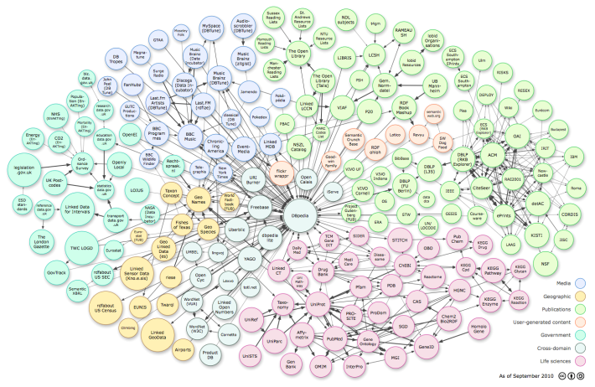
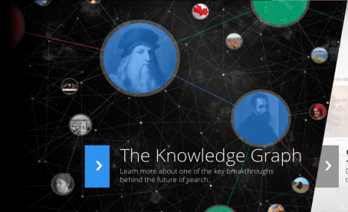
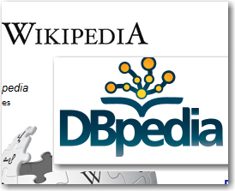
Knowledge Bases are Triple Stores
Represents facts of the world in a machine readable form
SUBJECT
PREDICATE
OBJECT
+
-
Machine Readable
Utilize Background Knowledge in Applications
Provide Additional Information (Search)
Many False Facts
Incomplete
Only few attempts to represent triple-uncertainty

Slide 4
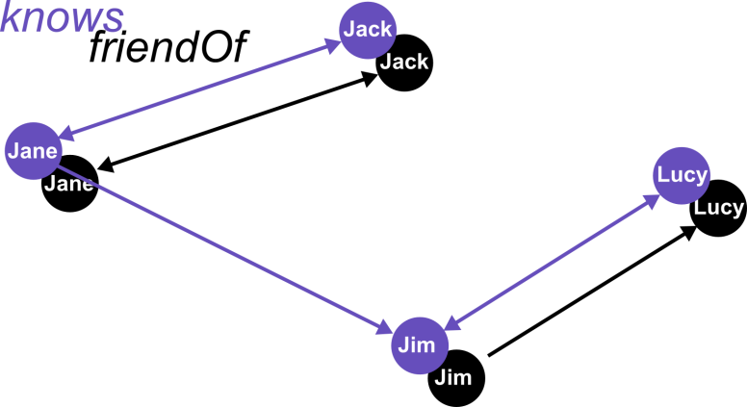
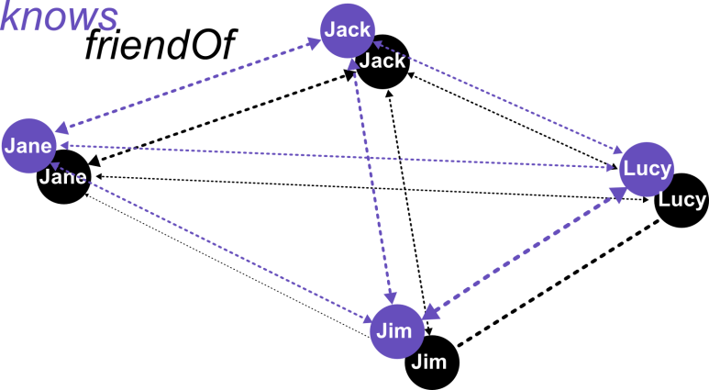
Benefits of Exploiting Uncertainty in Knowledge Bases
Probabilistic
Tuple-Independent Database
Deterministic Database
Subject | Object | P | RndVar
Jack | Jane | 0.7 | Y₁
Jack | Lucy | 0.2 | Y₂
Jack | Jim | 0.4 | Y₃
Jane | Lucy | 0.4 | Y₄
… | … | … | …
Subject | Object | P | RndVar
Jack | Jane | 0.5 | X₁
Jack | Lucy | 0.1 | X₂
Jack | Jim | 0.1 | X₃
Jane | Lucy | 0.4 | X₄
… | … | … | …
Subject | Object
Jack | Jane
Jane | Jim
Jim | Lucy
Subject | Object
Jack | Jane
Jim | Lucy
?
?
0.5
0.2
?
?
0.7
0.1
?
0.4
?
p≥0.5
0.4
?
?
?
0.5
0.4
0.1
?
?
0.1
0.8
?
0.7
“Does Jack know someone who is a friend of Lucy?”
“No, Jack does not know such a person.”
“Jack might know such a person with a probability of 63%.”*
*Considering that a person knows and is a friend of itself

Slide 5
Challenges when Exploiting Uncertainty in Knowledge Bases
Probabilistic
Tuple-Independent Database
Deterministic Database
Subject | Object | P | RndVar
Jack | Jane | 0.7 | Y₁
Jack | Lucy | 0.2 | Y₂
Jack | Jim | 0.4 | Y₃
Jane | Lucy | 0.4 | Y₄
… | … | … | …
Subject | Object
Jack | Jane
Jane | Jim
Jim | Lucy
Subject | Object | P | RndVar
Jack | Jane | 0.5 | X₁
Jack | Lucy | 0.1 | X₂
Jack | Jim | 0.1 | X₃
Jane | Lucy | 0.4 | X₄
… | … | … | …
Subject | Object
Jack | Jane
Jim | Lucy
Reintroducing Uncertainty
Can be intractable for larger KBs
Millions of Entities
Thousands of Relation Types
Intractable many possible triples
0.5
0.2
0.7
?
?
?
0.1
0.4
?
?
0.4
RESCAL
?
0.4
0.1
0.5
?
?
?
0.8
0.1
?
?
0.7
?
Complex Querying
“Does Jack know someone who is a friend of Lucy?”
Unsafe queries can be intractable due to exponential complexity (#P)
Safe queries
polynomial complexity
can lead to long query processing times.
“Jack might know such a person with a probability of 63%.”*
*Considering that a person knows and is a friend of itself

Slide 6
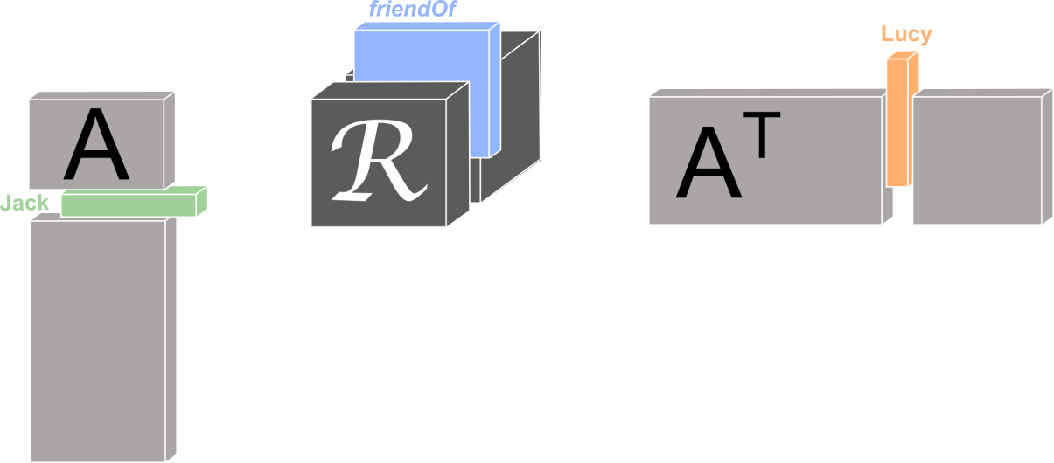
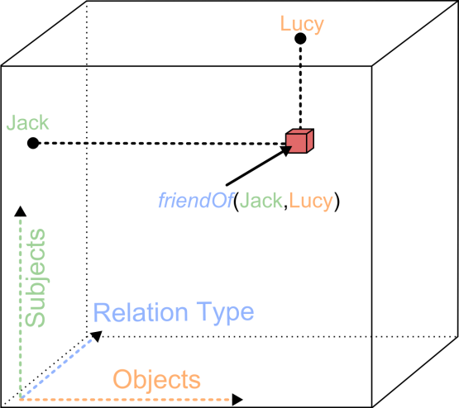
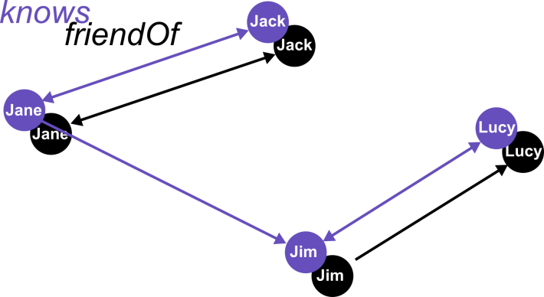
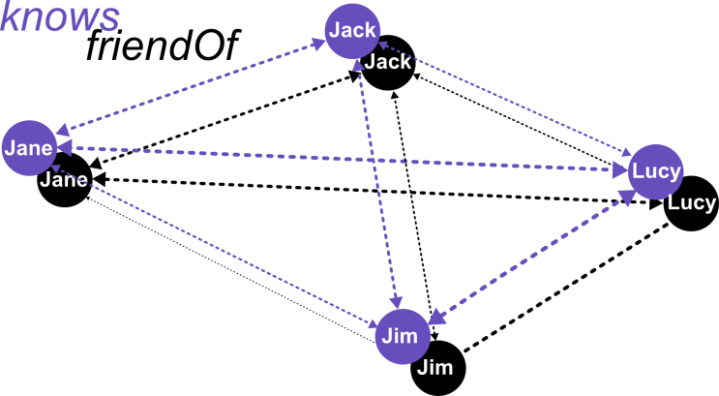
Probabilistic KB Construction with RESCAL
Adjacency Tensor
×
×
≈
Explicit
Representation
1.6 ×10¹¹
^{Triples}
Factorized
Representation
225 × 10⁶
^{Parameters}
Denis Krompaß et al.
Large-Scale Factorization of
Type-Constrained Multi-Relational Data.
DSAA’2014
1.0
-∞
+∞
Subject | Object | P | RndVar
Jack | Jane | 0.6 | Y₁
Jack | Lucy | 0.2 | Y₂
Jack | Jim | 0.4 | Y₃
Jane | Lucy | 0.8 | Y₄
… | … | … | …
?
?
0.5
0.2
?
?
?
0.6
0.8
0.1
?
0.7
?
?
?
0.5
0.4
0.1
Subject | Object | P | RndVar
Jack | Jane | 0.5 | X₁
Jack | Lucy | 0.1 | X₂
Jack | Jim | 0.1 | X₃
Jane | Lucy | 0.7 | X₄
… | … | … | …
?
?
?
0.1
0.8
0.5
Subject | Object
Jack | Jane
Jane | Jim
Jim | Lucy
Subject | Object
Jack | Jane
Jim | Lucy
Query a triple:
„Is Jack a friend of Lucy?“
„Jack might be a friend of Lucy with a probability of 0.1 %“

Slide 7
Complex Querying: Pure Extensional Query Evaluation on Factorized PKBs
0.5
0.2
For each existential quantifier the independent-project rule has to be applied
Nested loops
0.6
0.8
0.1
0.7
0.5
0.4
0.1
0.1
0.8
0.5
“Does Jack know someone who is a friend of Lucy?”
Complexity scales already cubic in the size of the database if we ask the query for all persons in the database
“Does Jack know a soccer player?”

Slide 8
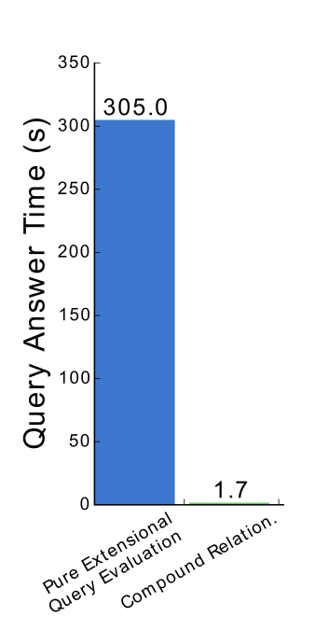
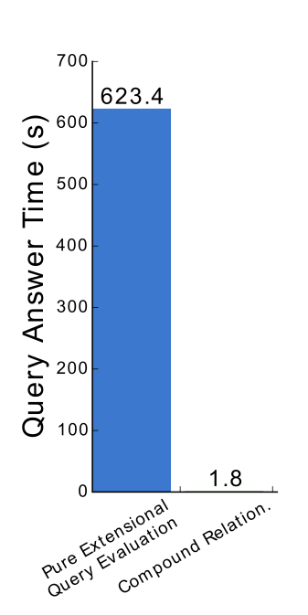
Querying DBpedia-Music (44345 Entities, 7 Relations)
„What songs or albums from the Pop-Rock genre are from musical artists that have/had a contract with Atlantic Records?“
„Which musical artists from the Hip-Hop Music genre have/had a contract with Shady , Aftermath or Death Row Records?“
<2 seconds

Slide 9
Avoiding Independent-Project
“Does Jack know a soccer player?”
Construct deterministic compound relation X_{(*)}
Approximate latent representation of compound relation
Initial Deterministic KB
Factorized KB
knows(), soccer()
knowsSoccerPlayerOf()
A is already known from past factorization of the initial KB
X_{(*)}

Slide 10
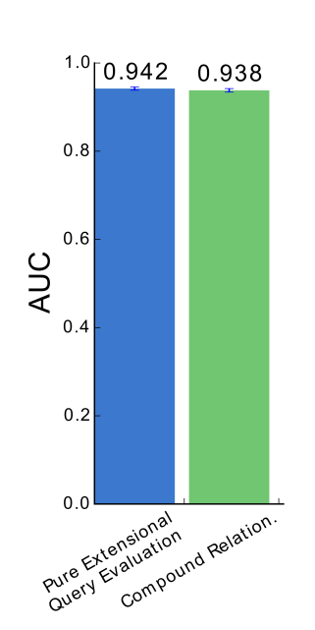
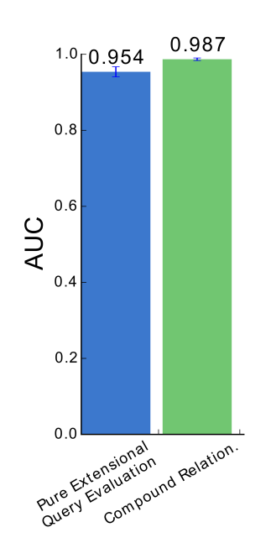
Querying DBpedia-Music (44345 Entities, 7 Relations)
„What songs or albums from the Pop-Rock genre are from musical artists that have/had a contract with Atlantic Records?“
„Which musical artists from the Hip-Hop Music genre have/had a contract with Shady , Aftermath or Death Row Records?“

Slide 11
Querying DBpedia-Music (44345 Entities, 7 Relations)
„Which musical artists from the Hip-Hop music genre are associated with musical artists that have/had a contract with Interscope Records and are involved in an album whose first letter is a ‘T’?“
Pure Extensional
Query Evaluation
Exploiting Approximated
Compound-Relations
Processing not finished
after 6 hours!
3.6 seconds
AUC: 0.985

Slide 12
Summary
Uncertainty can be reintroduced into deterministic representations of Knowledge Bases with RESCAL
The factorized Representation can be exploited for complex querying
Extensional query evaluation can be significantly accelerated by exploiting the RESCAL model (Compound Relations)

Slide 13
Questions ?
http://www.dbs.ifi.lmu.de/~krompass/ Denis.Krompass@campus.lmu.de

